Slide 1
CMOS Summer internship ppt
NIT Raipur

Slide 2
CMOS {internship}
Introduction to CMOS scaling
It’s History
It’s Application
It’s Working
It’s limitation
Fin-FET {application ,working, adv and dis-adv, compare with CMOS}
Technology mode {180nm, 90nm, …}
Difference b/w long and short channel
LT spice software
Spice Modelling

Slide 3
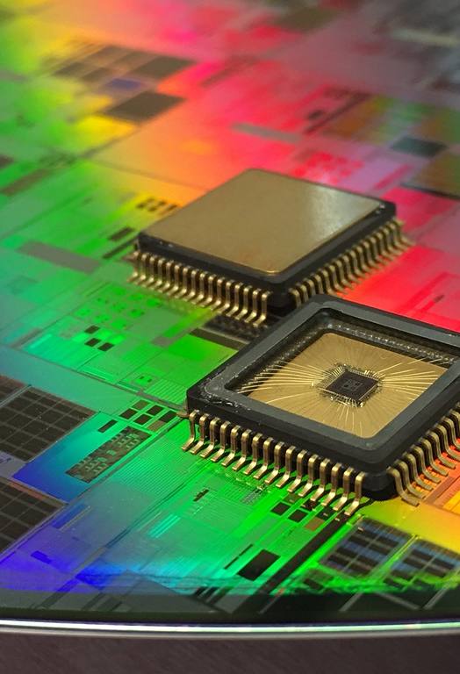
Introduction to cmos
CMOS (Complementary Metal-Oxide-Semiconductor) technology has been the backbone of the semiconductor industry.
It behaves as logic gate.
It’s components are pmos & nmos.

Slide 4
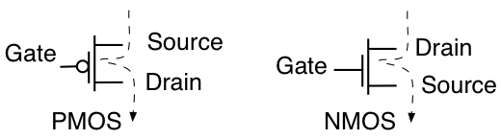
In pmos when Gate= 0V, then pmos will short circuit, act as ON,
while when Gate= 1V, then pmos will open circuit, act as OFF.
In nmos when Gate= 0V, then nmos will open circuit, act as OFF,
while when Gate= 1V, then nmos will short circuit, act as ON.

Slide 5
Cmos scaling
Defines as reduction of the dimension of different parameters of MOSFET.
Why Scaling ???
Increase device packing density.
Improve speed or frequency response (1/L).
Improve current drive (Transconductance Gm).
Decrease Power consumption

Slide 6
TYPES OF SCALING
Constant Field Scaling or Full Scaling:
In this, all the parameter of the MOSFET is scaled to understand it in a better way we will consider a case, suppose the scaling factor is “S” who’s values greater than 1 (S>1) now consider all the parameters of MOSFET is scaled by scaling factor “S” then it’s all parameter will get changed to a new value.
For example, if the original gate length is “L” then after scaling it will become L’ = L/S
In a similar way, all parameters of the MOSFET will get changed to their new value hence this type of scaling is known as the Full Scaling.
2) Constant Voltage Scaling:
In this only, the physical parameters of the MOSFET are Scaled-down such as the Gate length of the MOSFET is decreased, and this result In a Short Channel Effect which will directly affect the Drain Current, therefore the drain Current is Inversely proportional to gate length. And electrical Parameters are kept constant, such as the terminal voltage of the MOSFET is kept constant.

Slide 7
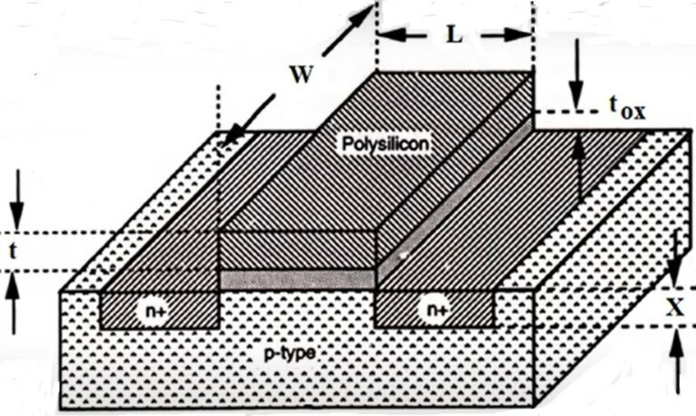
3) Lateral Scaling:
In this type of scaling only the width of the gate channel is scaled. It’s commonly called a gate shrink. This type of scaling is used only in specific applications. the disadvantage associate with this type is the high electric field through the channel and hence it also causes a short channel effect.
SCALING OF MOSFET

Slide 8
PARAMETER | BEFORE SCALING | AFTER SCALING
 |  | FULL SCALING | VOLTAGE CONSTANT SCALING
Channel length | L | L’ =L/s | L’ =L/s
Channel width | W | W’ =W/s | W’ =W/s
Gate oxide thickness | tox | tox’ =tox/s | tox’ =tox/s
Junction depth | Xj | Xj’ =Xj/s | Xj’ =Xj/s
Power supply voltage | VDD | VDD’ =VDD/s | VDD’ =VDD
Threshold voltage | VTO | VTO’ =VTO/s | VTO’ =VTO
Doping density | NA, ND | NA’, ND’ =sNA, sND | NA’, ND’ =s²NA, s²ND
Oxide capacitance | COX | COX’ =COX/s | COX’ =COX/S
Drain current | ID | ID’ =s.ID | ID’ =s.ID
Power dissipation | PD | PD’ =PD/s² | PD’ =S.PD
Power density | PD/Area | PD/Area’ =PD/Area | PD/Area’ =s³.PD/Area

Slide 9

History of cmos
1963: Invention by Frank Wanlass at Fairchild Semiconductor.
1970s: Commercial adoption for low-power devices.
1980s: Dominance in microprocessors and memory.
1990s: Key to the rise of personal computing.
2000s: Central to the mobile device revolution.
2010s: Advanced techniques like FinFETs and high-k/metal gates.
2020s: Innovations in materials, 3D integration, and quantum computing.

Slide 10
Working of cmos
CMOS works on the principle of:
CMOS operates using complementary pairs of MOSFETs for low-power, noise-immune digital logic.
In CMOS logic gates a collection of n-type MOSFETs is arranged in a pull-down network between the output and the low voltage (Vss or ground).
Instead of the load resistor of NMOS logic gates, CMOS logic gates have a collection of p-type MOSFETs in a pull-up network between the output and the higher-voltage (Vdd).
Furthermore, for better understanding of CMOS working principle, we need to discuss various logic gates(which discuss bellow).

Slide 11
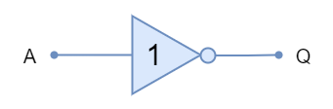
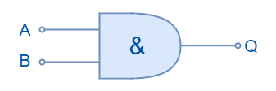
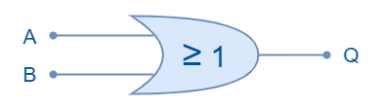
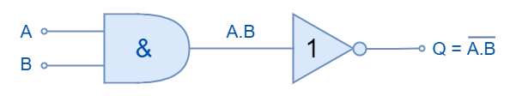
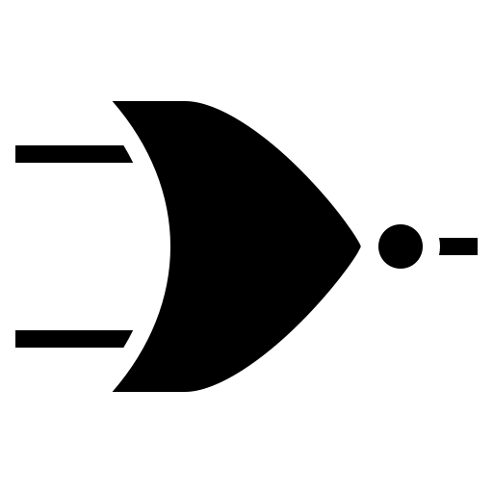
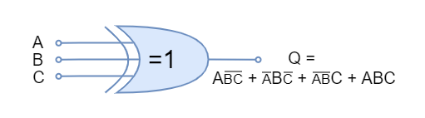
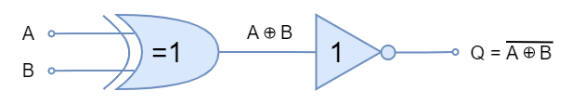
NAME | SYMBOL | BOOLEAN
NOT |  | Y=a̅
AND |  | Y=a.b
OR |  | Y=a+b
NAND |  | Y=(ab)̅
NOR |  | Y=(a+b)̅
XOR |  | Y=(a⊕b)
XNOR |  | Y=(a⊕b)̅

Slide 12
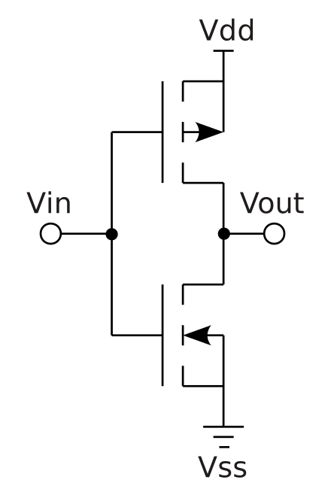
Cmos structure of INVERTER
NMOS Transistor (Pull-down Network):
The NMOS transistor is connected between the output and ground.
When the input is high (logic 1), the NMOS transistor conducts, providing a path to ground and pulling the output low (logic 0).
PMOS Transistor (Pull-up Network):
The PMOS transistor is connected between the output and the supply voltage (Vdd).
When the input is low (logic 0), the PMOS transistor conducts, providing a path to Vdd and pulling the output high (logic 1).
This Photo by Unknown Author is licensed under CC BY-SA

Slide 13
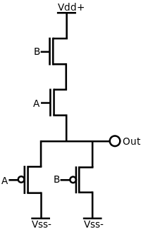
Cmos structure of nand gate
NMOS Transistors (N1 and N2):
The sources of N1 and N2 are connected to ground (Vss-).
The gates of N1 and N2 are connected to the input signals A and B, respectively.
The drains of N1 and N2 are connected together.
PMOS Transistors (P1 and P2):
The sources of P1 and P2 are connected to the positive power supply voltage (Vdd+).
The gates of P1 and P2 are connected to the complement (inverted) of the input signals A and B, respectively.
The drains of P1 and P2 are connected together.
Output (C):
The output C is taken from the drains of both NMOS and PMOS transistors.
C

Slide 14
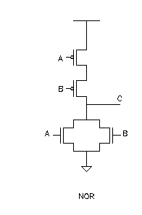
Cmos structure of nor gate
PMOS Network:
Connect PMOS transistors in parallel between the output node and the power supply (Vdd).
The gate of each PMOS transistor is connected to each input of the NOR gate.
NMOS Network:
Connect NMOS transistors in series between the output node and the ground (GND).
The gate of each NMOS transistor is connected to each input of the NOR gate.
Output Node:
The output node is the point where the PMOS and NMOS networks meet.
This Photo by Unknown Author is licensed under CC BY-SA

Slide 15
Fin-FET
It is Type of Multi Gate MOSFET.
It is widely use over planar CMOS FET.
Fin is the channel in between Source and Drain.
FinFET can have two or four or more Fin in same structure.
It gives following advantages over FET
Area of performance
Lower Power Leakage
Low Voltage operation
Low Retention Voltage for SRAM
Better control over Current

Slide 16
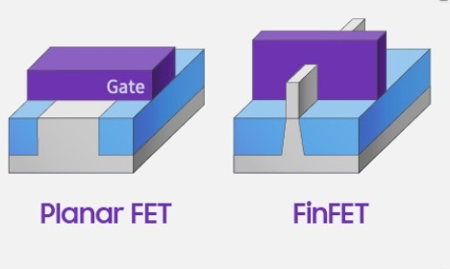
Structure of FinFET
GATE
Fin
Ox
Ox

Slide 17
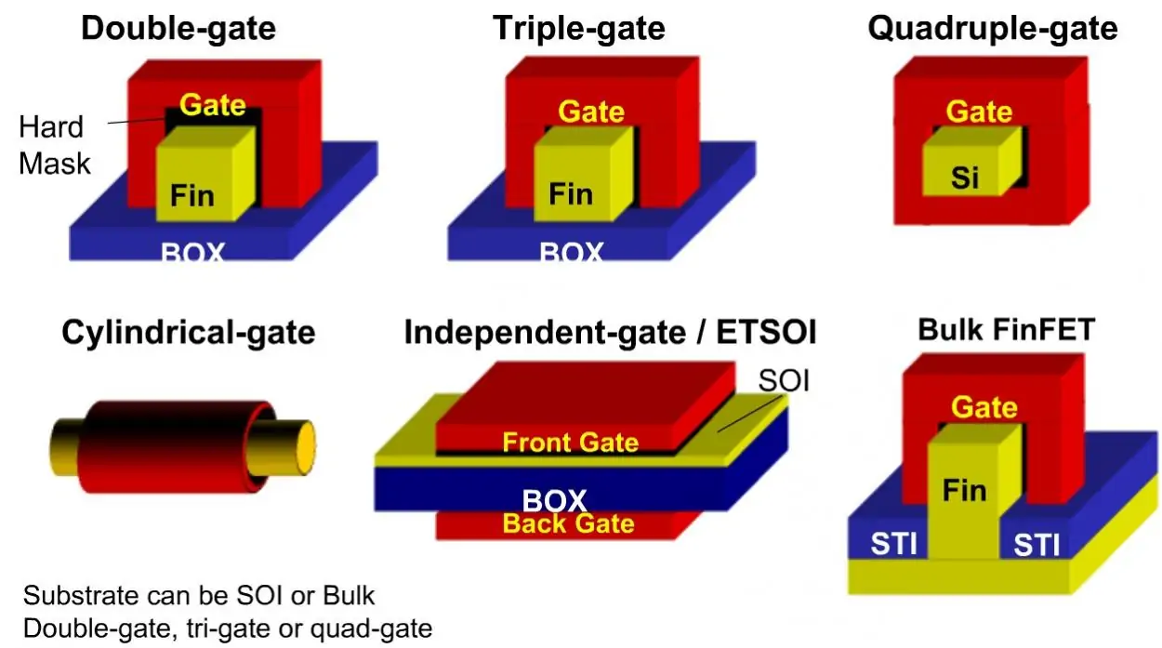
Double Gate & Tri Gate FinFET

Slide 18
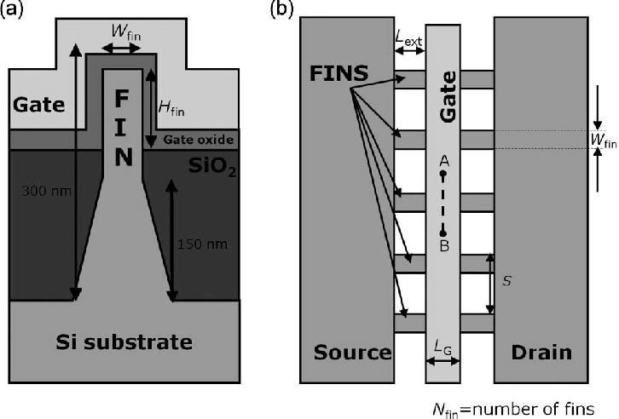
TOP VIEW OF FinFET
(a) Front View
(b) Top View

Slide 19
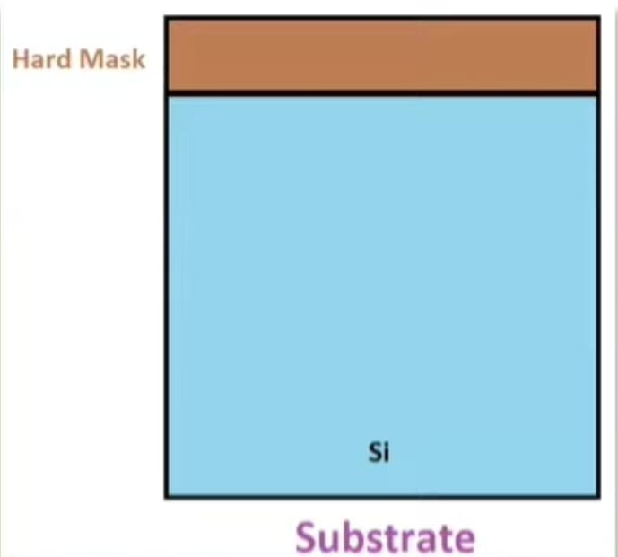
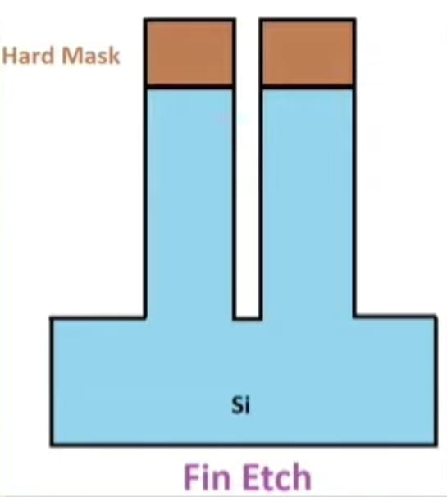
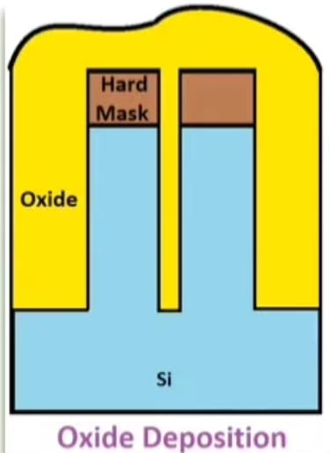
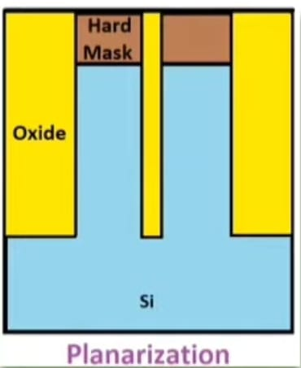
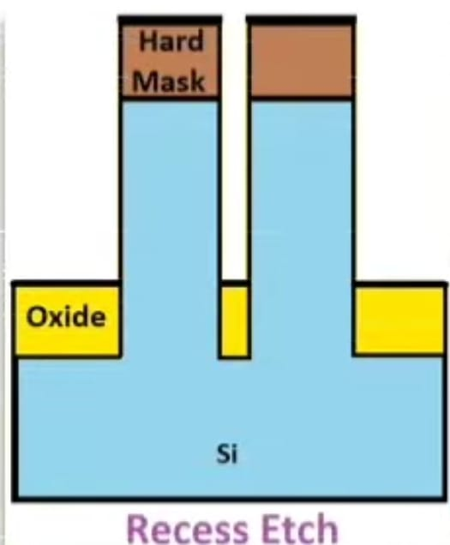
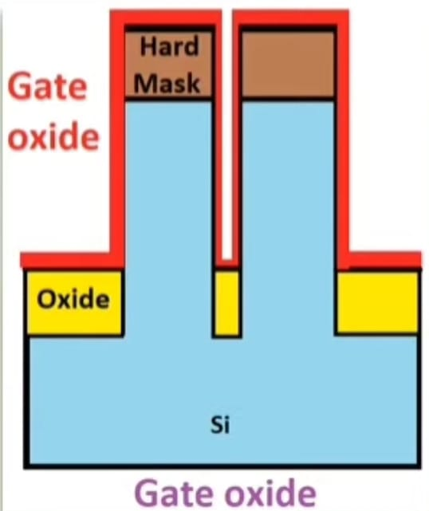
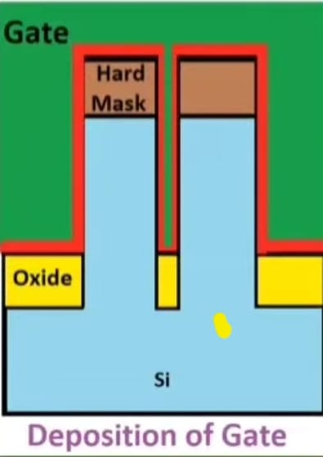
FABRICATION PROCESS OF FinFET
Hard Mask
Substrate: Here, first lightly doped P Type substrate fabricated and then hard mask is fabricated over that substrate.
Fin Etch: Then by a highly an isotropic process fins formed.
Oxide Deposition: Over Fins oxide layers are formed to isolate the fins.
Planarization: It is planarized by chemical and mechanical polishing process.
Recess Etch: By this process excess oxide is etched.
Gate Oxide: To isolate the channel from gate by thermal oxidation process gate oxide is deposited over the fins.
Deposition of the Gate: Highly doped N+ poly Silicon gate layer is formed and deposited over fins.
Si

Slide 20
Advantages of FinFEET
Area of performance
Lower Power Leakage
Low Voltage operation
Low Retention Voltage for SRAM
Better control over Current
Disadvantages of FinFET
Fabrication cost is higher than CMOS circuit.
Controlling of Fin Depth is difficult.
Application of FinFET
Used in various application like:
Microprocessor
Microcontroller
Smart Phone
Compact chip

Slide 21
PARAMETER | CMOS | FIN-FET
1)Structure | Planar Two-dimensional transistors. | Three-dimensional with a vertical fin and gate wrapping around it.
2) Performance | Faces challenges with leakage current and short-channel effects at smaller nodes. | Better control over the channel, reducing leakage and short-channel effects, enabling higher speeds.
3) Power Consumption | Higher static and dynamic power consumption at advanced nodes. | Lower static and dynamic power consumption due to better electrostatic control.
4) Scalability | Limited by physical and practical challenges at very small scales. | More scalable, allowing for continued performance improvements at smaller nodes.
5) Manufacturing Complexity | Well-established but increasingly complex for smaller nodes. | More complex manufacturing process, but offers significant performance and efficiency benefits.

Slide 22
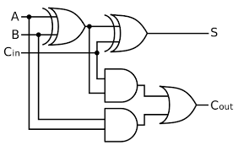
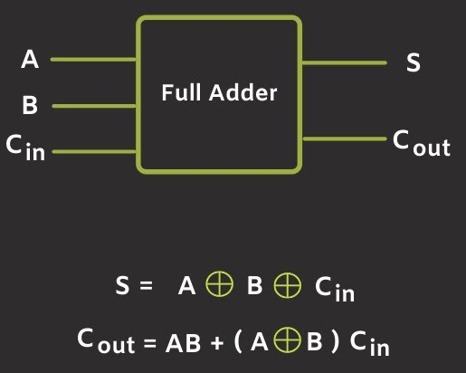
FULL-ADDER

Slide 23
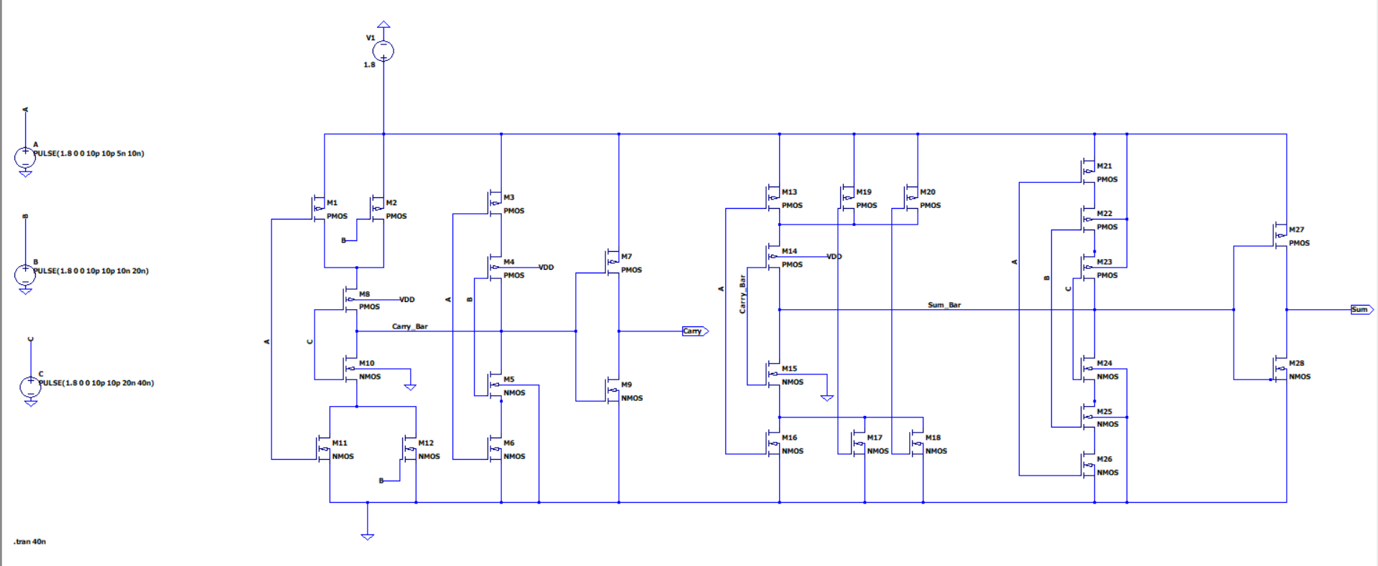
Full Adder via Ltspice

Slide 24
Models of 50nm pmos and nmos
.model P_50n pmos level=54 +binunit=1 paramchk=1 mobmod=0 +capmod=2 igcmod=1 igbmod=1 geomod=0 +diomod=1 rdsmod=0 rbodymod=1 rgatemod=1 +permod=1 acnqsmod=0 trnqsmod=0 +tnom=27 toxe=1.4e-009 toxp=7e-010 toxm=1.4e-009 +epsrox=3.9 wint=5e-009 lint=1.2e-008 +ll=0 wl=0 lln=1 wln=1 +lw=0 ww=0 lwn=1 wwn=1 +lwl=0 wwl=0 xpart=0 toxref=1.4e-009 +vth0=-0.22 k1=0.39 k2=0.05 k3=0 +k3b=0 w0=2.5e-006 dvt0=3.9 dvt1=0.635 +dvt2=-0.032 dvt0w=0 dvt1w=0 dvt2w=0 +dsub=0.7 minv=0.05 voffl=0 dvtp0=0.5e-008 +dvtp1=0.05 lpe0=5.75e-008 lpeb=2.3e-010 xj=2e-008 +ngate=5e+020 ndep=2.8e+018 nsd=1e+020 phin=0 +cdsc=0.000258 cdscb=0 cdscd=6.1e-008 cit=0 +voff=-0.15 nfactor=2 eta0=0.15 etab=0 +vfb=0.55 u0=0.0095 ua=1.6e-009 ub=8e-018 +uc=4.6e-013 vsat=90000 a0=1.2 ags=1e-020 +a1=0 a2=1 b0=-1e-020 b1=0 +keta=-0.047 dwg=0 dwb=0 pclm=0.55 +pdiblc1=0.03 pdiblc2=0.0055 pdiblcb=3.4e-008 drout=0.56 +pvag=1e-020 delta=0.014 pscbe1=8.14e+008 pscbe2=9.58e-007 +fprout=0.2 pdits=0.2 pditsd=0.23 pditsl=2.3e+006 +rsh=3 rdsw=250 rsw=160 rdw=160 +rdswmin=0 rdwmin=0 rswmin=0 prwg=3.22e-008 +prwb=6.8e-011 wr=1 alpha0=0.074 alpha1=0.005 +beta0=30 agidl=0.0002 bgidl=2.1e+009 cgidl=0.0002 +egidl=0.8 +aigbacc=0.012 bigbacc=0.0028 cigbacc=0.002 +nigbacc=1 aigbinv=0.014 bigbinv=0.004 cigbinv=0.004 +eigbinv=1.1 nigbinv=3 aigc=0.69 bigc=0.0012 +cigc=0.0008 aigsd=0.0087 bigsd=0.0012 cigsd=0.0008 +nigc=1 poxedge=1 pigcd=1 ntox=1 +xrcrg1=12 xrcrg2=5 +cgso=7.43e-010 cgdo=7.43e-010 cgbo=2.56e-011 cgdl=1e-014 +cgsl=1e-014 ckappas=0.5 ckappad=0.5 acde=1 +moin=15 noff=0.9 voffcv=0.02 +kt1=-0.19 kt1l=0 kt2=-0.052 ute=-1.5 +ua1=-1e-009 ub1=2e-018 uc1=0 prt=0 +at=33000 +fnoimod=1 tnoimod=0 +jss=0.0001 jsws=1e-011 jswgs=1e-010 njs=1 +ijthsfwd=0.01 ijthsrev=0.001 bvs=10 xjbvs=1 +jsd=0.0001 jswd=1e-011 jswgd=1e-010 njd=1 +ijthdfwd=0.01 ijthdrev=0.001 bvd=10 xjbvd=1 +pbs=1 cjs=0.0005 mjs=0.5 pbsws=1 +cjsws=5e-010 mjsws=0.33 pbswgs=1 cjswgs=5e-010 +mjswgs=0.33 pbd=1 cjd=0.0005 mjd=0.5 +pbswd=1 cjswd=5e-010 mjswd=0.33 pbswgd=1 +cjswgd=5e-010 mjswgd=0.33 tpb=0.005 tcj=0.001 +tpbsw=0.005 tcjsw=0.001 tpbswg=0.005 tcjswg=0.001 +xtis=3 xtid=3 +dmcg=0e-006 dmci=0e-006 dmdg=0e-006 dmcgt=0e-007 +dwj=0e-008 xgw=0e-007 xgl=0e-008 +rshg=0.4 gbmin=1e-010 rbpb=5 rbpd=15 +rbps=15 rbdb=15 rbsb=15 ngcon=1

Slide 25
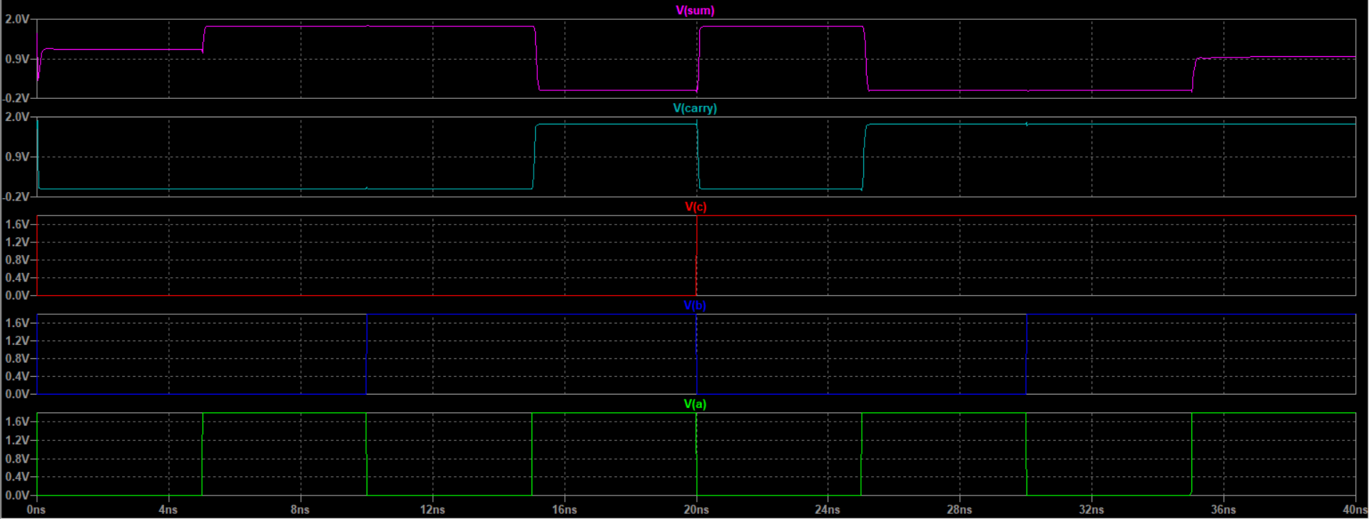
It’s Output Characteristics :

Slide 26
Models of 32nm pmos and nmos
* PTM High Performance 32nm Metal Gate / High-K / Strained-Si * nominal Vdd = 0.9V .model nmos nmos level = 54 +version = 4.0 binunit = 1 paramchk= 1 mobmod = 0 +capmod = 2 igcmod = 1 igbmod = 1 geomod = 1 +diomod = 1 rdsmod = 0 rbodymod= 1 rgatemod= 1 +permod = 1 acnqsmod= 0 trnqsmod= 0 +tnom = 27 toxe = 1.15e-009 toxp = 9e-010 toxm = 1.15e-009 +dtox = 2.5e-010 epsrox = 3.9 wint = 5e-009 lint = 2.7e-009 +ll = 0 wl = 0 lln = 1 wln = 1 +lw = 0 ww = 0 lwn = 1 wwn = 1 +lwl = 0 wwl = 0 xpart = 0 toxref = 1.15e-009 +xl = -14e-9 +vth0 = 0.49396 k1 = 0.4 k2 = 0 k3 = 0 +k3b = 0 w0 = 2.5e-006 dvt0 = 1 dvt1 = 2 +dvt2 = 0 dvt0w = 0 dvt1w = 0 dvt2w = 0 +dsub = 0.1 minv = 0.05 voffl = 0 dvtp0 = 1e-011 +dvtp1 = 0.1 lpe0 = 0 lpeb = 0 xj = 1e-008 +ngate = 1e+023 ndep = 4.12e+018 nsd = 2e+020 phin = 0 +cdsc = 0 cdscb = 0 cdscd = 0 cit = 0 +voff = -0.13 nfactor = 2.508 eta0 = 0.0048 etab = 0 +vfb = -0.55 u0 = 0.05 ua = 6e-010 ub = 1.2e-018 +uc = 0 vsat = 210000 a0 = 1 ags = 0 +a1 = 0 a2 = 1 b0 = 0 b1 = 0 +keta = 0.04 dwg = 0 dwb = 0 pclm = 0.02 +pdiblc1 = 0.001 pdiblc2 = 0.001 pdiblcb = -0.005 drout = 0.5 +pvag = 1e-020 delta = 0.01 pscbe1 = 8.14e+008 pscbe2 = 1e-007 +fprout = 0.2 pdits = 0.01 pditsd = 0.23 pditsl = 2300000 +rsh = 5 rdsw = 150 rsw = 75 rdw = 75 +rdswmin = 0 rdwmin = 0 rswmin = 0 prwg = 0 +prwb = 0 wr = 1 alpha0 = 0.074 alpha1 = 0.005 +beta0 = 30 agidl = 0.0002 bgidl = 2.1e+009 cgidl = 0.0002 +egidl = 0.8 aigbacc = 0.012 bigbacc = 0.0028 cigbacc = 0.002 +nigbacc = 1 aigbinv = 0.014 bigbinv = 0.004 cigbinv = 0.004 +eigbinv = 1.1 nigbinv = 3 aigc = 0.020014 bigc = 0.0027432 +cigc = 0.002 aigsd = 0.020014 bigsd = 0.0027432 cigsd = 0.002 +nigc = 1 poxedge = 1 pigcd = 1 ntox = 1 +xrcrg1 = 12 xrcrg2 = 5 +cgso = 8.5e-011 cgdo = 8.5e-011 cgbo = 2.56e-011 cgdl = 2.653e-010 +cgsl = 2.653e-010 ckappas = 0.03 ckappad = 0.03 acde = 1 +moin = 15 noff = 0.9 voffcv = 0.02 +kt1 = -0.11 kt1l = 0 kt2 = 0.022 ute = -1.5 +ua1 = 4.31e-009 ub1 = 7.61e-018 uc1 = -5.6e-011 prt = 0 +at = 33000 +fnoimod = 1 tnoimod = 0 +jss = 0.0001 jsws = 1e-011 jswgs = 1e-010 njs = 1 +ijthsfwd= 0.01 ijthsrev= 0.001 bvs = 10 xjbvs = 1 +jsd = 0.0001 jswd = 1e-011 jswgd = 1e-010 njd = 1 +ijthdfwd= 0.01 ijthdrev= 0.001 bvd = 10 xjbvd = 1 +pbs = 1 cjs = 0.0005 mjs = 0.5 pbsws = 1 +cjsws = 5e-010 mjsws = 0.33 pbswgs = 1 cjswgs = 3e-010 +mjswgs = 0.33 pbd = 1 cjd = 0.0005 mjd = 0.5 +pbswd = 1 cjswd = 5e-010 mjswd = 0.33 pbswgd = 1 +cjswgd = 5e-010 mjswgd = 0.33 tpb = 0.005 tcj = 0.001 +tpbsw = 0.005 tcjsw = 0.001 tpbswg = 0.005 tcjswg = 0.001 +xtis = 3 xtid = 3 +dmcg = 0 dmci = 0 dmdg = 0 dmcgt = 0 +dwj = 0 xgw = 0 xgl = 0 +rshg = 0.4 gbmin = 1e-010 rbpb = 5 rbpd = 15 +rbps = 15 rbdb = 15 rbsb = 15 ngcon = 1 .model pmos pmos level = 54 +version = 4.0 binunit = 1 paramchk= 1 mobmod = 0 +capmod = 2 igcmod = 1 igbmod = 1 geomod = 1 +diomod = 1 rdsmod = 0 rbodymod= 1 rgatemod= 1 +permod = 1 acnqsmod= 0 trnqsmod= 0 +tnom = 27 toxe = 1.2e-009 toxp = 9e-010 toxm = 1.2e-009 +dtox = 3e-010 epsrox = 3.9 wint = 5e-009 lint = 2.7e-009 +ll = 0 wl = 0 lln = 1 wln = 1 +lw = 0 ww = 0 lwn = 1 wwn = 1 +lwl = 0 wwl = 0 xpart = 0 toxref = 1.2e-009 +xl = -14e-9 +vth0 = -0.49155 k1 = 0.4 k2 = -0.01 k3 = 0 +k3b = 0 w0 = 2.5e-006 dvt0 = 1 dvt1 = 2 +dvt2 = -0.032 dvt0w = 0 dvt1w = 0 dvt2w = 0 +dsub = 0.1 minv = 0.05 voffl = 0 dvtp0 = 1e-011 +dvtp1 = 0.05 lpe0 = 0 lpeb = 0 xj = 1e-008 +ngate = 1e+023 ndep = 3.07e+018 nsd = 2e+020 phin = 0 +cdsc = 0 cdscb = 0 cdscd = 0 cit = 0 +voff = -0.126 nfactor = 2.1 eta0 = 0.0048 etab = 0 +vfb = 0.55 u0 = 0.014 ua = 2e-009 ub = 5e-019 +uc = 0 vsat = 180000 a0 = 1 ags = 1e-020 +a1 = 0 a2 = 1 b0 = 0 b1 = 0 +keta = -0.047 dwg = 0 dwb = 0 pclm = 0.12 +pdiblc1 = 0.001 pdiblc2 = 0.001 pdiblcb = 3.4e-008 drout = 0.56 +pvag = 1e-020 delta = 0.01 pscbe1 = 8.14e+008 pscbe2 = 9.58e-007 +fprout = 0.2 pdits = 0.08 pditsd = 0.23 pditsl = 2300000 +rsh = 5 rdsw = 150 rsw = 75 rdw = 75 +rdswmin = 0 rdwmin = 0 rswmin = 0 prwg = 0 +prwb = 0 wr = 1 alpha0 = 0.074 alpha1 = 0.005 +beta0 = 30 agidl = 0.0002 bgidl = 2.1e+009 cgidl = 0.0002 +egidl = 0.8 aigbacc = 0.012 bigbacc = 0.0028 cigbacc = 0.002 +nigbacc = 1 aigbinv = 0.014 bigbinv = 0.004 cigbinv = 0.004 +eigbinv = 1.1 nigbinv = 3 aigc = 0.020014 bigc = 0.0027432 +cigc = 0.002 aigsd = 0.020014 bigsd = 0.0027432 cigsd = 0.002 +nigc = 1 poxedge = 1 pigcd = 1 ntox = 1 +xrcrg1 = 12 xrcrg2 = 5 +cgso = 8.5e-011 cgdo = 8.5e-011 cgbo = 2.56e-011 cgdl = 2.653e-010 +cgsl = 2.653e-010 ckappas = 0.03 ckappad = 0.03 acde = 1 +moin = 15 noff = 0.9 voffcv = 0.02 +kt1 = -0.11 kt1l = 0 kt2 = 0.022 ute = -1.5 +ua1 = 4.31e-009 ub1 = 7.61e-018 uc1 = -5.6e-011 prt = 0 +at = 33000 +fnoimod = 1 tnoimod = 0 +jss = 0.0001 jsws = 1e-011 jswgs = 1e-010 njs = 1 +ijthsfwd= 0.01 ijthsrev= 0.001 bvs = 10 xjbvs = 1 +jsd = 0.0001 jswd = 1e-011 jswgd = 1e-010 njd = 1 +ijthdfwd= 0.01 ijthdrev= 0.001 bvd = 10 xjbvd = 1 +pbs = 1 cjs = 0.0005 mjs = 0.5 pbsws = 1 +cjsws = 5e-010 mjsws = 0.33 pbswgs = 1 cjswgs = 3e-010 +mjswgs = 0.33 pbd = 1 cjd = 0.0005 mjd = 0.5 +pbswd = 1 cjswd = 5e-010 mjswd = 0.33 pbswgd = 1 +cjswgd = 5e-010 mjswgd = 0.33 tpb = 0.005 tcj = 0.001 +tpbsw = 0.005 tcjsw = 0.001 tpbswg = 0.005 tcjswg = 0.001 +xtis = 3 xtid = 3 +dmcg = 0 dmci = 0 dmdg = 0 dmcgt = 0 +dwj = 0 xgw = 0 xgl = 0 +rshg = 0.4 gbmin = 1e-010 rbpb = 5 rbpd = 15 +rbps = 15 rbdb = 15 rbsb = 15 ngcon = 1

Slide 27
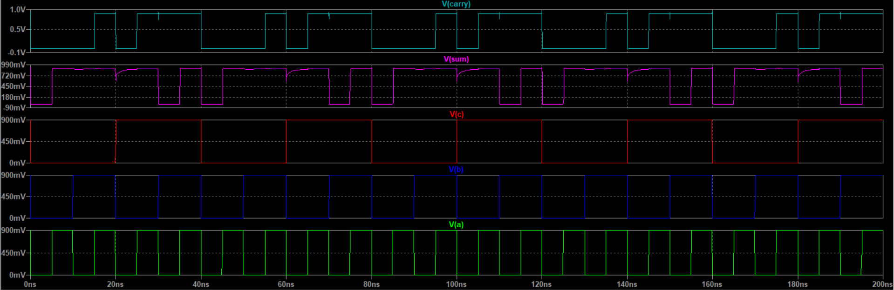
It’s Output Characteristics :

Slide 28
Models of 45nm pmos and nmos
* PTM High Performance 45nm Metal Gate / High-K / Strained-Si * nominal Vdd = 1.0V .model nmos nmos level = 54 +version = 4.0 binunit = 1 paramchk= 1 mobmod = 0 +capmod = 2 igcmod = 1 igbmod = 1 geomod = 1 +diomod = 1 rdsmod = 0 rbodymod= 1 rgatemod= 1 +permod = 1 acnqsmod= 0 trnqsmod= 0 +tnom = 27 toxe = 1.25e-009 toxp = 1e-009 toxm = 1.25e-009 +dtox = 2.5e-010 epsrox = 3.9 wint = 5e-009 lint = 3.75e-009 +ll = 0 wl = 0 lln = 1 wln = 1 +lw = 0 ww = 0 lwn = 1 wwn = 1 +lwl = 0 wwl = 0 xpart = 0 toxref = 1.25e-009 +xl = -20e-9 +vth0 = 0.46893 k1 = 0.4 k2 = 0 k3 = 0 +k3b = 0 w0 = 2.5e-006 dvt0 = 1 dvt1 = 2 +dvt2 = 0 dvt0w = 0 dvt1w = 0 dvt2w = 0 +dsub = 0.1 minv = 0.05 voffl = 0 dvtp0 = 1e-010 +dvtp1 = 0.1 lpe0 = 0 lpeb = 0 xj = 1.4e-008 +ngate = 1e+023 ndep = 3.24e+018 nsd = 2e+020 phin = 0 +cdsc = 0 cdscb = 0 cdscd = 0 cit = 0 +voff = -0.13 nfactor = 2.22 eta0 = 0.0055 etab = 0 +vfb = -0.55 u0 = 0.054 ua = 6e-010 ub = 1.2e-018 +uc = 0 vsat = 170000 a0 = 1 ags = 0 +a1 = 0 a2 = 1 b0 = 0 b1 = 0 +keta = 0.04 dwg = 0 dwb = 0 pclm = 0.02 +pdiblc1 = 0.001 pdiblc2 = 0.001 pdiblcb = -0.005 drout = 0.5 +pvag = 1e-020 delta = 0.01 pscbe1 = 8.14e+008 pscbe2 = 1e-007 +fprout = 0.2 pdits = 0.08 pditsd = 0.23 pditsl = 2300000 +rsh = 5 rdsw = 155 rsw = 80 rdw = 80 +rdswmin = 0 rdwmin = 0 rswmin = 0 prwg = 0 +prwb = 0 wr = 1 alpha0 = 0.074 alpha1 = 0.005 +beta0 = 30 agidl = 0.0002 bgidl = 2.1e+009 cgidl = 0.0002 +egidl = 0.8 aigbacc = 0.012 bigbacc = 0.0028 cigbacc = 0.002 +nigbacc = 1 aigbinv = 0.014 bigbinv = 0.004 cigbinv = 0.004 +eigbinv = 1.1 nigbinv = 3 aigc = 0.02 bigc = 0.0025 +cigc = 0.002 aigsd = 0.02 bigsd = 0.0025 cigsd = 0.002 +nigc = 1 poxedge = 1 pigcd = 1 ntox = 1 +xrcrg1 = 12 xrcrg2 = 5 +cgso = 1.1e-010 cgdo = 1.1e-010 cgbo = 2.56e-011 cgdl = 2.653e-010 +cgsl = 2.653e-010 ckappas = 0.03 ckappad = 0.03 acde = 1 +moin = 15 noff = 0.9 voffcv = 0.02 +kt1 = -0.11 kt1l = 0 kt2 = 0.022 ute = -1.5 +ua1 = 4.31e-009 ub1 = 7.61e-018 uc1 = -5.6e-011 prt = 0 +at = 33000 +fnoimod = 1 tnoimod = 0 +jss = 0.0001 jsws = 1e-011 jswgs = 1e-010 njs = 1 +ijthsfwd= 0.01 ijthsrev= 0.001 bvs = 10 xjbvs = 1 +jsd = 0.0001 jswd = 1e-011 jswgd = 1e-010 njd = 1 +ijthdfwd= 0.01 ijthdrev= 0.001 bvd = 10 xjbvd = 1 +pbs = 1 cjs = 0.0005 mjs = 0.5 pbsws = 1 +cjsws = 5e-010 mjsws = 0.33 pbswgs = 1 cjswgs = 3e-010 +mjswgs = 0.33 pbd = 1 cjd = 0.0005 mjd = 0.5 +pbswd = 1 cjswd = 5e-010 mjswd = 0.33 pbswgd = 1 +cjswgd = 5e-010 mjswgd = 0.33 tpb = 0.005 tcj = 0.001 +tpbsw = 0.005 tcjsw = 0.001 tpbswg = 0.005 tcjswg = 0.001 +xtis = 3 xtid = 3 +dmcg = 0 dmci = 0 dmdg = 0 dmcgt = 0 +dwj = 0 xgw = 0 xgl = 0 +rshg = 0.4 gbmin = 1e-010 rbpb = 5 rbpd = 15 +rbps = 15 rbdb = 15 rbsb = 15 ngcon = 1 .model pmos pmos level = 54 +version = 4.0 binunit = 1 paramchk= 1 mobmod = 0 +capmod = 2 igcmod = 1 igbmod = 1 geomod = 1 +diomod = 1 rdsmod = 0 rbodymod= 1 rgatemod= 1 +permod = 1 acnqsmod= 0 trnqsmod= 0 +tnom = 27 toxe = 1.3e-009 toxp = 1e-009 toxm = 1.3e-009 +dtox = 3e-010 epsrox = 3.9 wint = 5e-009 lint = 3.75e-009 +ll = 0 wl = 0 lln = 1 wln = 1 +lw = 0 ww = 0 lwn = 1 wwn = 1 +lwl = 0 wwl = 0 xpart = 0 toxref = 1.3e-009 +xl = -20e-9 +vth0 = -0.49158 k1 = 0.4 k2 = -0.01 k3 = 0 +k3b = 0 w0 = 2.5e-006 dvt0 = 1 dvt1 = 2 +dvt2 = -0.032 dvt0w = 0 dvt1w = 0 dvt2w = 0 +dsub = 0.1 minv = 0.05 voffl = 0 dvtp0 = 1e-011 +dvtp1 = 0.05 lpe0 = 0 lpeb = 0 xj = 1.4e-008 +ngate = 1e+023 ndep = 2.44e+018 nsd = 2e+020 phin = 0 +cdsc = 0 cdscb = 0 cdscd = 0 cit = 0 +voff = -0.126 nfactor = 2.1 eta0 = 0.0055 etab = 0 +vfb = 0.55 u0 = 0.02 ua = 2e-009 ub = 5e-019 +uc = 0 vsat = 150000 a0 = 1 ags = 1e-020 +a1 = 0 a2 = 1 b0 = 0 b1 = 0 +keta = -0.047 dwg = 0 dwb = 0 pclm = 0.12 +pdiblc1 = 0.001 pdiblc2 = 0.001 pdiblcb = 3.4e-008 drout = 0.56 +pvag = 1e-020 delta = 0.01 pscbe1 = 8.14e+008 pscbe2 = 9.58e-007 +fprout = 0.2 pdits = 0.08 pditsd = 0.23 pditsl = 2300000 +rsh = 5 rdsw = 155 rsw = 75 rdw = 75 +rdswmin = 0 rdwmin = 0 rswmin = 0 prwg = 0 +prwb = 0 wr = 1 alpha0 = 0.074 alpha1 = 0.005 +beta0 = 30 agidl = 0.0002 bgidl = 2.1e+009 cgidl = 0.0002 +egidl = 0.8 aigbacc = 0.012 bigbacc = 0.0028 cigbacc = 0.002 +nigbacc = 1 aigbinv = 0.014 bigbinv = 0.004 cigbinv = 0.004 +eigbinv = 1.1 nigbinv = 3 aigc = 0.010687 bigc = 0.0012607 +cigc = 0.0008 aigsd = 0.010687 bigsd = 0.0012607 cigsd = 0.0008 +nigc = 1 poxedge = 1 pigcd = 1 ntox = 1 +xrcrg1 = 12 xrcrg2 = 5 +cgso = 1.1e-010 cgdo = 1.1e-010 cgbo = 2.56e-011 cgdl = 2.653e-010 +cgsl = 2.653e-010 ckappas = 0.03 ckappad = 0.03 acde = 1 +moin = 15 noff = 0.9 voffcv = 0.02 +kt1 = -0.11 kt1l = 0 kt2 = 0.022 ute = -1.5 +ua1 = 4.31e-009 ub1 = 7.61e-018 uc1 = -5.6e-011 prt = 0 +at = 33000 +fnoimod = 1 tnoimod = 0 +jss = 0.0001 jsws = 1e-011 jswgs = 1e-010 njs = 1 +ijthsfwd= 0.01 ijthsrev= 0.001 bvs = 10 xjbvs = 1 +jsd = 0.0001 jswd = 1e-011 jswgd = 1e-010 njd = 1 +ijthdfwd= 0.01 ijthdrev= 0.001 bvd = 10 xjbvd = 1 +pbs = 1 cjs = 0.0005 mjs = 0.5 pbsws = 1 +cjsws = 5e-010 mjsws = 0.33 pbswgs = 1 cjswgs = 3e-010 +mjswgs = 0.33 pbd = 1 cjd = 0.0005 mjd = 0.5 +pbswd = 1 cjswd = 5e-010 mjswd = 0.33 pbswgd = 1 +cjswgd = 5e-010 mjswgd = 0.33 tpb = 0.005 tcj = 0.001 +tpbsw = 0.005 tcjsw = 0.001 tpbswg = 0.005 tcjswg = 0.001 +xtis = 3 xtid = 3 +dmcg = 0 dmci = 0 dmdg = 0 dmcgt = 0 +dwj = 0 xgw = 0 xgl = 0 +rshg = 0.4 gbmin = 1e-010 rbpb = 5 rbpd = 15 +rbps = 15 rbdb = 15 rbsb = 15 ngcon = 1

Slide 29
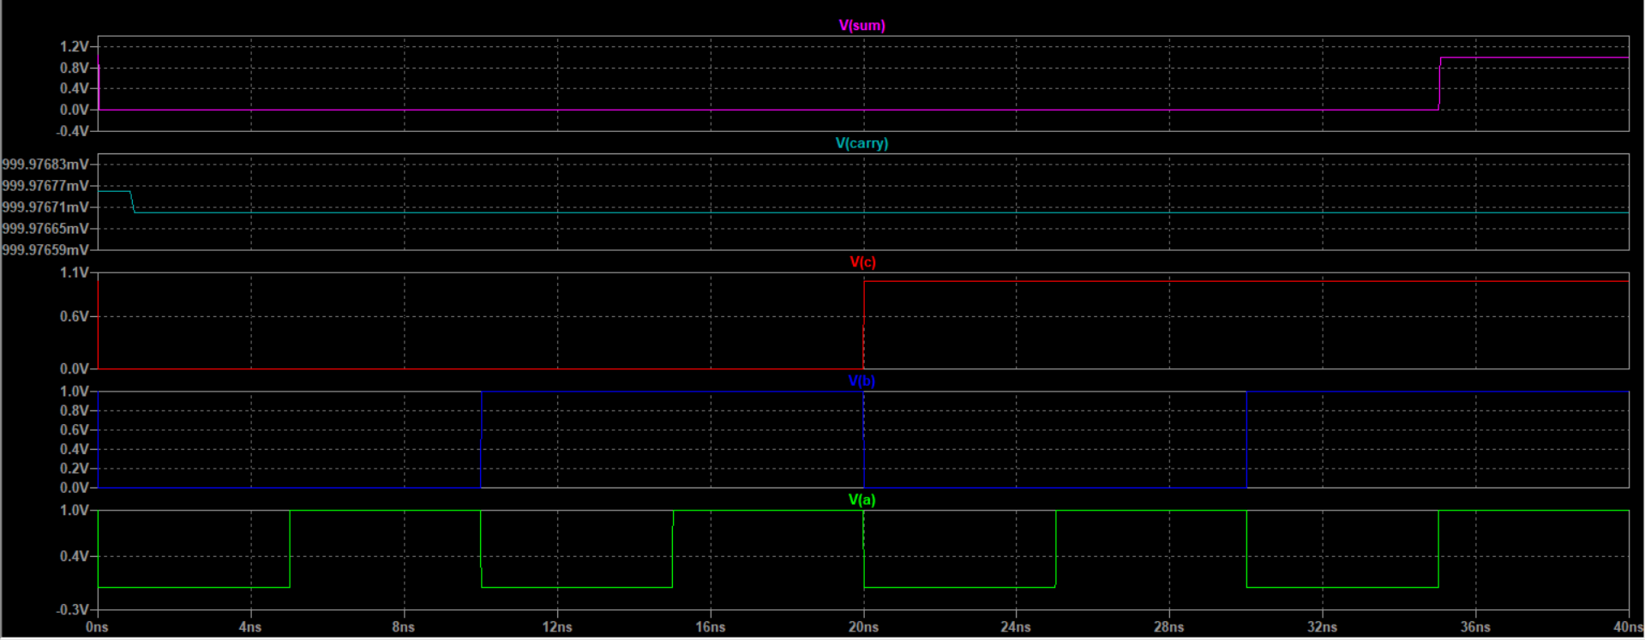
It’s Output Characteristics :

Slide 30
Models of 22nm pmos and nmos
* PTM High Performance 22nm Metal Gate / High-K / Strained-Si * nominal Vdd = 0.8V .model nmos nmos level = 54 +version = 4.0 binunit = 1 paramchk= 1 mobmod = 0 +capmod = 2 igcmod = 1 igbmod = 1 geomod = 1 +diomod = 1 rdsmod = 0 rbodymod= 1 rgatemod= 1 +permod = 1 acnqsmod= 0 trnqsmod= 0 +tnom = 27 toxe = 1.05e-009 toxp = 8e-010 toxm = 1.05e-009 +dtox = 2.5e-010 epsrox = 3.9 wint = 5e-009 lint = 2e-009 +ll = 0 wl = 0 lln = 1 wln = 1 +lw = 0 ww = 0 lwn = 1 wwn = 1 +lwl = 0 wwl = 0 xpart = 0 toxref = 1.05e-009 +xl = -9e-9 +vth0 = 0.50308 k1 = 0.4 k2 = 0 k3 = 0 +k3b = 0 w0 = 2.5e-006 dvt0 = 1 dvt1 = 2 +dvt2 = 0 dvt0w = 0 dvt1w = 0 dvt2w = 0 +dsub = 0.1 minv = 0.05 voffl = 0 dvtp0 = 1e-011 +dvtp1 = 0.1 lpe0 = 0 lpeb = 0 xj = 7.2e-009 +ngate = 1e+023 ndep = 5.5e+018 nsd = 2e+020 phin = 0 +cdsc = 0 cdscb = 0 cdscd = 0 cit = 0 +voff = -0.13 nfactor = 2.3 eta0 = 0.004 etab = 0 +vfb = -0.55 u0 = 0.04 ua = 6e-010 ub = 1.2e-018 +uc = 0 vsat = 250000 a0 = 1 ags = 0 +a1 = 0 a2 = 1 b0 = 0 b1 = 0 +keta = 0.04 dwg = 0 dwb = 0 pclm = 0.02 +pdiblc1 = 0.001 pdiblc2 = 0.001 pdiblcb = -0.005 drout = 0.5 +pvag = 1e-020 delta = 0.01 pscbe1 = 8.14e+008 pscbe2 = 1e-007 +fprout = 0.2 pdits = 0.01 pditsd = 0.23 pditsl = 2300000 +rsh = 5 rdsw = 145 rsw = 75 rdw = 75 +rdswmin = 0 rdwmin = 0 rswmin = 0 prwg = 0 +prwb = 0 wr = 1 alpha0 = 0.074 alpha1 = 0.005 +beta0 = 30 agidl = 0.0002 bgidl = 2.1e+009 cgidl = 0.0002 +egidl = 0.8 aigbacc = 0.012 bigbacc = 0.0028 cigbacc = 0.002 +nigbacc = 1 aigbinv = 0.014 bigbinv = 0.004 cigbinv = 0.004 +eigbinv = 1.1 nigbinv = 3 aigc = 0.0213 bigc = 0.0025889 +cigc = 0.002 aigsd = 0.0213 bigsd = 0.0025889 cigsd = 0.002 +nigc = 1 poxedge = 1 pigcd = 1 ntox = 1 +xrcrg1 = 12 xrcrg2 = 5 +cgso = 6.5e-011 cgdo = 6.5e-011 cgbo = 2.56e-011 cgdl = 2.653e-010 +cgsl = 2.653e-010 ckappas = 0.03 ckappad = 0.03 acde = 1 +moin = 15 noff = 0.9 voffcv = 0.02 +kt1 = -0.11 kt1l = 0 kt2 = 0.022 ute = -1.5 +ua1 = 4.31e-009 ub1 = 7.61e-018 uc1 = -5.6e-011 prt = 0 +at = 33000 +fnoimod = 1 tnoimod = 0 +jss = 0.0001 jsws = 1e-011 jswgs = 1e-010 njs = 1 +ijthsfwd= 0.01 ijthsrev= 0.001 bvs = 10 xjbvs = 1 +jsd = 0.0001 jswd = 1e-011 jswgd = 1e-010 njd = 1 +ijthdfwd= 0.01 ijthdrev= 0.001 bvd = 10 xjbvd = 1 +pbs = 1 cjs = 0.0005 mjs = 0.5 pbsws = 1 +cjsws = 5e-010 mjsws = 0.33 pbswgs = 1 cjswgs = 3e-010 +mjswgs = 0.33 pbd = 1 cjd = 0.0005 mjd = 0.5 +pbswd = 1 cjswd = 5e-010 mjswd = 0.33 pbswgd = 1 +cjswgd = 5e-010 mjswgd = 0.33 tpb = 0.005 tcj = 0.001 +tpbsw = 0.005 tcjsw = 0.001 tpbswg = 0.005 tcjswg = 0.001 +xtis = 3 xtid = 3 +dmcg = 0 dmci = 0 dmdg = 0 dmcgt = 0 +dwj = 0 xgw = 0 xgl = 0 +rshg = 0.4 gbmin = 1e-010 rbpb = 5 rbpd = 15 +rbps = 15 rbdb = 15 rbsb = 15 ngcon = 1 .model pmos pmos level = 54 +version = 4.0 binunit = 1 paramchk= 1 mobmod = 0 +capmod = 2 igcmod = 1 igbmod = 1 geomod = 1 +diomod = 1 rdsmod = 0 rbodymod= 1 rgatemod= 1 +permod = 1 acnqsmod= 0 trnqsmod= 0 +tnom = 27 toxe = 1.1e-009 toxp = 8e-010 toxm = 1.1e-009 +dtox = 3e-010 epsrox = 3.9 wint = 5e-009 lint = 2e-009 +ll = 0 wl = 0 lln = 1 wln = 1 +lw = 0 ww = 0 lwn = 1 wwn = 1 +lwl = 0 wwl = 0 xpart = 0 toxref = 1.1e-009 +xl = -9e-9 +vth0 = -0.4606 k1 = 0.4 k2 = -0.01 k3 = 0 +k3b = 0 w0 = 2.5e-006 dvt0 = 1 dvt1 = 2 +dvt2 = -0.032 dvt0w = 0 dvt1w = 0 dvt2w = 0 +dsub = 0.1 minv = 0.05 voffl = 0 dvtp0 = 1e-011 +dvtp1 = 0.05 lpe0 = 0 lpeb = 0 xj = 7.2e-009 +ngate = 1e+023 ndep = 4.4e+018 nsd = 2e+020 phin = 0 +cdsc = 0 cdscb = 0 cdscd = 0 cit = 0 +voff = -0.126 nfactor = 2.1 eta0 = 0.0038 etab = 0 +vfb = 0.55 u0 = 0.0095 ua = 2e-009 ub = 5e-019 +uc = 0 vsat = 210000 a0 = 1 ags = 1e-020 +a1 = 0 a2 = 1 b0 = 0 b1 = 0 +keta = -0.047 dwg = 0 dwb = 0 pclm = 0.12 +pdiblc1 = 0.001 pdiblc2 = 0.001 pdiblcb = 3.4e-008 drout = 0.56 +pvag = 1e-020 delta = 0.01 pscbe1 = 8.14e+008 pscbe2 = 9.58e-007 +fprout = 0.2 pdits = 0.08 pditsd = 0.23 pditsl = 2300000 +rsh = 5 rdsw = 145 rsw = 72.5 rdw = 72.5 +rdswmin = 0 rdwmin = 0 rswmin = 0 prwg = 0 +prwb = 0 wr = 1 alpha0 = 0.074 alpha1 = 0.005 +beta0 = 30 agidl = 0.0002 bgidl = 2.1e+009 cgidl = 0.0002 +egidl = 0.8 aigbacc = 0.012 bigbacc = 0.0028 cigbacc = 0.002 +nigbacc = 1 aigbinv = 0.014 bigbinv = 0.004 cigbinv = 0.004 +eigbinv = 1.1 nigbinv = 3 aigc = 0.0213 bigc = 0.0025889 +cigc = 0.002 aigsd = 0.0213 bigsd = 0.0025889 cigsd = 0.002 +nigc = 1 poxedge = 1 pigcd = 1 ntox = 1 +xrcrg1 = 12 xrcrg2 = 5 +cgso = 6.5e-011 cgdo = 6.5e-011 cgbo = 2.56e-011 cgdl = 2.653e-010 +cgsl = 2.653e-010 ckappas = 0.03 ckappad = 0.03 acde = 1 +moin = 15 noff = 0.9 voffcv = 0.02 +kt1 = -0.11 kt1l = 0 kt2 = 0.022 ute = -1.5 +ua1 = 4.31e-009 ub1 = 7.61e-018 uc1 = -5.6e-011 prt = 0 +at = 33000 +fnoimod = 1 tnoimod = 0 +jss = 0.0001 jsws = 1e-011 jswgs = 1e-010 njs = 1 +ijthsfwd= 0.01 ijthsrev= 0.001 bvs = 10 xjbvs = 1 +jsd = 0.0001 jswd = 1e-011 jswgd = 1e-010 njd = 1 +ijthdfwd= 0.01 ijthdrev= 0.001 bvd = 10 xjbvd = 1 +pbs = 1 cjs = 0.0005 mjs = 0.5 pbsws = 1 +cjsws = 5e-010 mjsws = 0.33 pbswgs = 1 cjswgs = 3e-010 +mjswgs = 0.33 pbd = 1 cjd = 0.0005 mjd = 0.5 +pbswd = 1 cjswd = 5e-010 mjswd = 0.33 pbswgd = 1 +cjswgd = 5e-010 mjswgd = 0.33 tpb = 0.005 tcj = 0.001 +tpbsw = 0.005 tcjsw = 0.001 tpbswg = 0.005 tcjswg = 0.001 +xtis = 3 xtid = 3 +dmcg = 0 dmci = 0 dmdg = 0 dmcgt = 0 +dwj = 0 xgw = 0 xgl = 0 +rshg = 0.4 gbmin = 1e-010 rbpb = 5 rbpd = 15 +rbps = 15 rbdb = 15 rbsb = 15 ngcon = 1

Slide 31
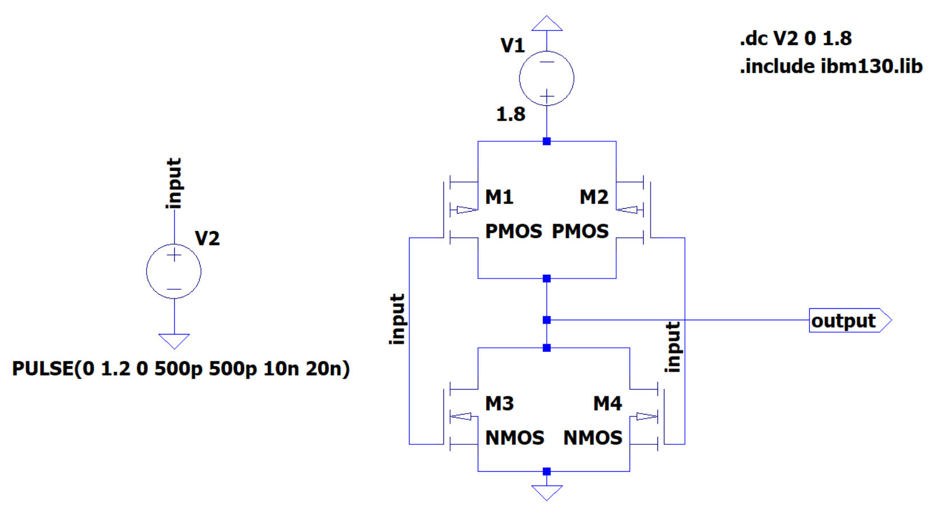
FinFET inverter in Ltspice

Slide 32
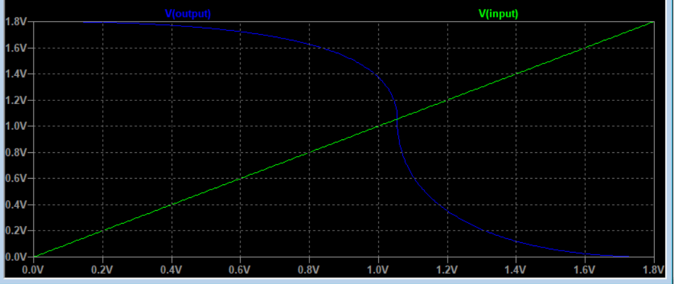
It’s Output Characteristics :

Slide 33
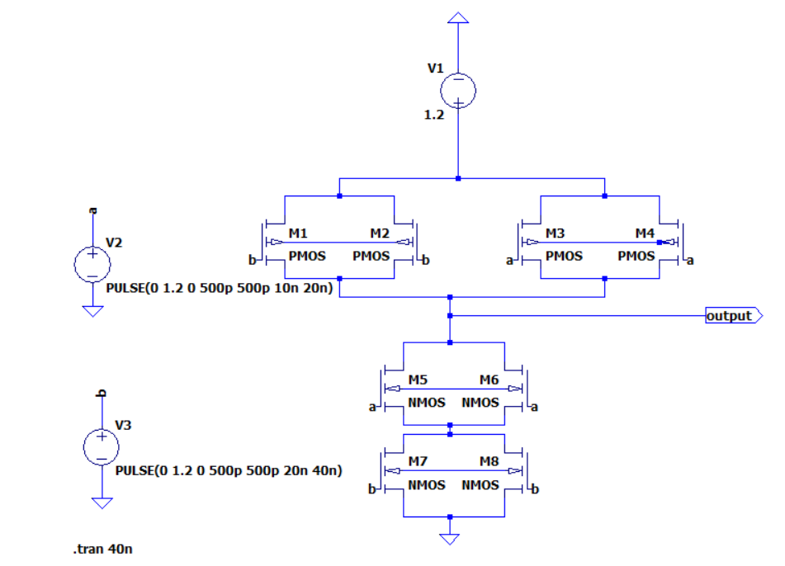
FinFET NAND in Ltspice

Slide 34
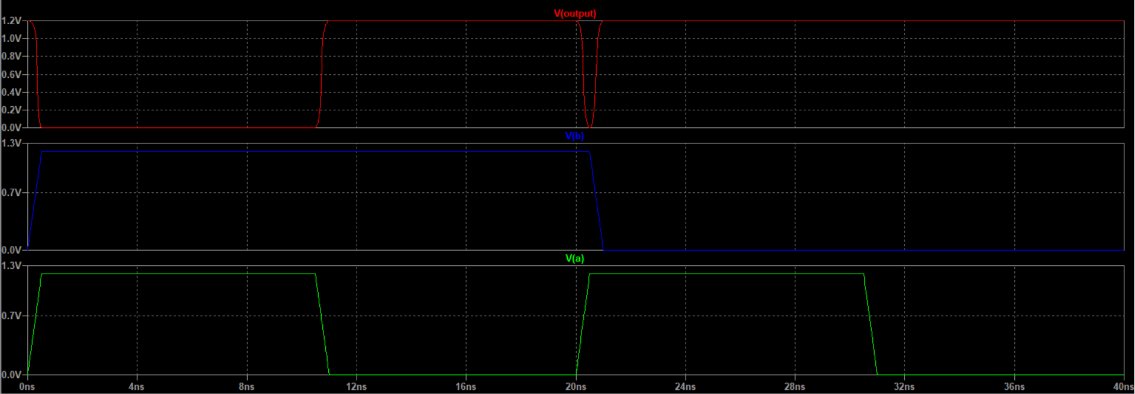
It’s Output Characteristics :

Slide 35
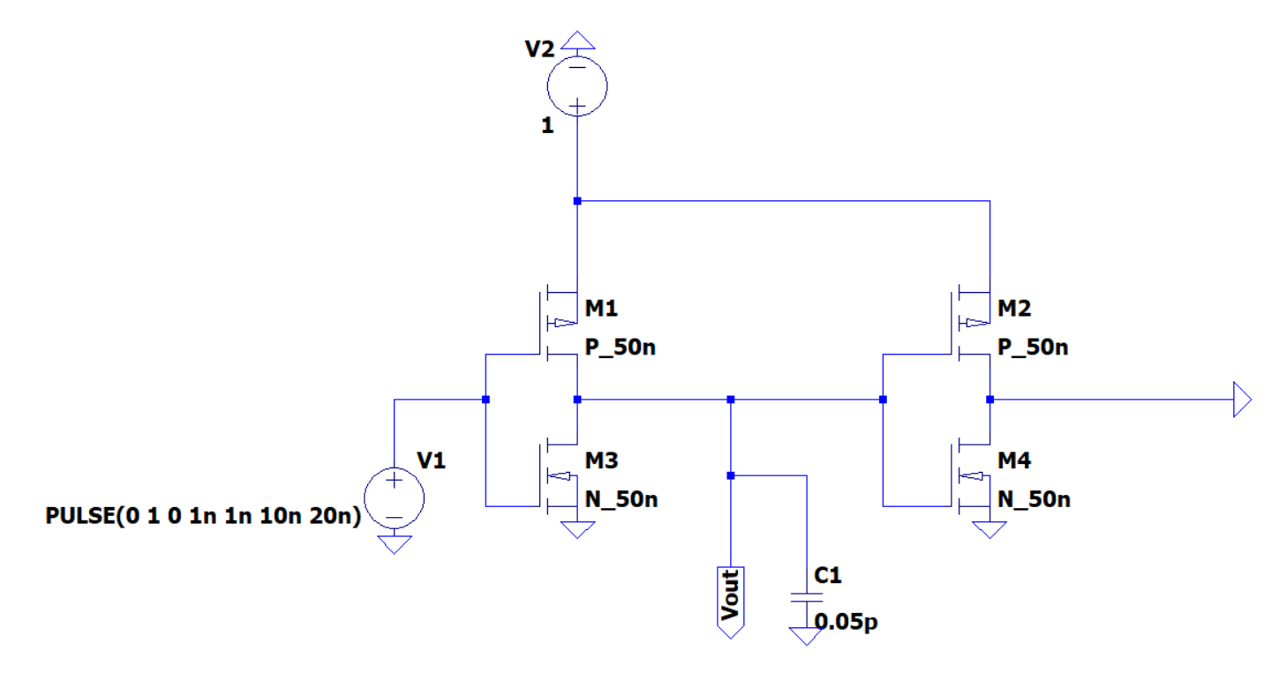
FO-4 Inverter

Slide 36
Models of 50nm pmos and nmos
.model P_50n pmos level=54 +binunit=1 paramchk=1 mobmod=0 +capmod=2 igcmod=1 igbmod=1 geomod=0 +diomod=1 rdsmod=0 rbodymod=1 rgatemod=1 +permod=1 acnqsmod=0 trnqsmod=0 +tnom=27 toxe=1.4e-009 toxp=7e-010 toxm=1.4e-009 +epsrox=3.9 wint=5e-009 lint=1.2e-008 +ll=0 wl=0 lln=1 wln=1 +lw=0 ww=0 lwn=1 wwn=1 +lwl=0 wwl=0 xpart=0 toxref=1.4e-009 +vth0=-0.22 k1=0.39 k2=0.05 k3=0 +k3b=0 w0=2.5e-006 dvt0=3.9 dvt1=0.635 +dvt2=-0.032 dvt0w=0 dvt1w=0 dvt2w=0 +dsub=0.7 minv=0.05 voffl=0 dvtp0=0.5e-008 +dvtp1=0.05 lpe0=5.75e-008 lpeb=2.3e-010 xj=2e-008 +ngate=5e+020 ndep=2.8e+018 nsd=1e+020 phin=0 +cdsc=0.000258 cdscb=0 cdscd=6.1e-008 cit=0 +voff=-0.15 nfactor=2 eta0=0.15 etab=0 +vfb=0.55 u0=0.0095 ua=1.6e-009 ub=8e-018 +uc=4.6e-013 vsat=90000 a0=1.2 ags=1e-020 +a1=0 a2=1 b0=-1e-020 b1=0 +keta=-0.047 dwg=0 dwb=0 pclm=0.55 +pdiblc1=0.03 pdiblc2=0.0055 pdiblcb=3.4e-008 drout=0.56 +pvag=1e-020 delta=0.014 pscbe1=8.14e+008 pscbe2=9.58e-007 +fprout=0.2 pdits=0.2 pditsd=0.23 pditsl=2.3e+006 +rsh=3 rdsw=250 rsw=160 rdw=160 +rdswmin=0 rdwmin=0 rswmin=0 prwg=3.22e-008 +prwb=6.8e-011 wr=1 alpha0=0.074 alpha1=0.005 +beta0=30 agidl=0.0002 bgidl=2.1e+009 cgidl=0.0002 +egidl=0.8 +aigbacc=0.012 bigbacc=0.0028 cigbacc=0.002 +nigbacc=1 aigbinv=0.014 bigbinv=0.004 cigbinv=0.004 +eigbinv=1.1 nigbinv=3 aigc=0.69 bigc=0.0012 +cigc=0.0008 aigsd=0.0087 bigsd=0.0012 cigsd=0.0008 +nigc=1 poxedge=1 pigcd=1 ntox=1 +xrcrg1=12 xrcrg2=5 +cgso=7.43e-010 cgdo=7.43e-010 cgbo=2.56e-011 cgdl=1e-014 +cgsl=1e-014 ckappas=0.5 ckappad=0.5 acde=1 +moin=15 noff=0.9 voffcv=0.02 +kt1=-0.19 kt1l=0 kt2=-0.052 ute=-1.5 +ua1=-1e-009 ub1=2e-018 uc1=0 prt=0 +at=33000 +fnoimod=1 tnoimod=0 +jss=0.0001 jsws=1e-011 jswgs=1e-010 njs=1 +ijthsfwd=0.01 ijthsrev=0.001 bvs=10 xjbvs=1 +jsd=0.0001 jswd=1e-011 jswgd=1e-010 njd=1 +ijthdfwd=0.01 ijthdrev=0.001 bvd=10 xjbvd=1 +pbs=1 cjs=0.0005 mjs=0.5 pbsws=1 +cjsws=5e-010 mjsws=0.33 pbswgs=1 cjswgs=5e-010 +mjswgs=0.33 pbd=1 cjd=0.0005 mjd=0.5 +pbswd=1 cjswd=5e-010 mjswd=0.33 pbswgd=1 +cjswgd=5e-010 mjswgd=0.33 tpb=0.005 tcj=0.001 +tpbsw=0.005 tcjsw=0.001 tpbswg=0.005 tcjswg=0.001 +xtis=3 xtid=3 +dmcg=0e-006 dmci=0e-006 dmdg=0e-006 dmcgt=0e-007 +dwj=0e-008 xgw=0e-007 xgl=0e-008 +rshg=0.4 gbmin=1e-010 rbpb=5 rbpd=15 +rbps=15 rbdb=15 rbsb=15 ngcon=1

Slide 37
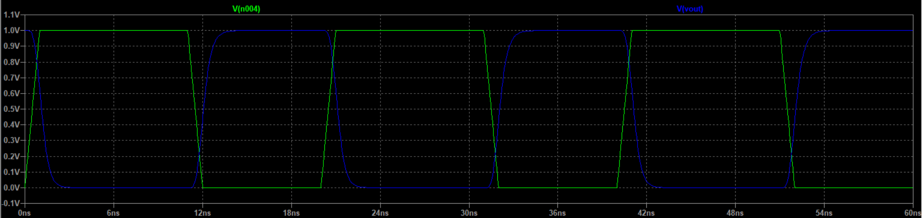
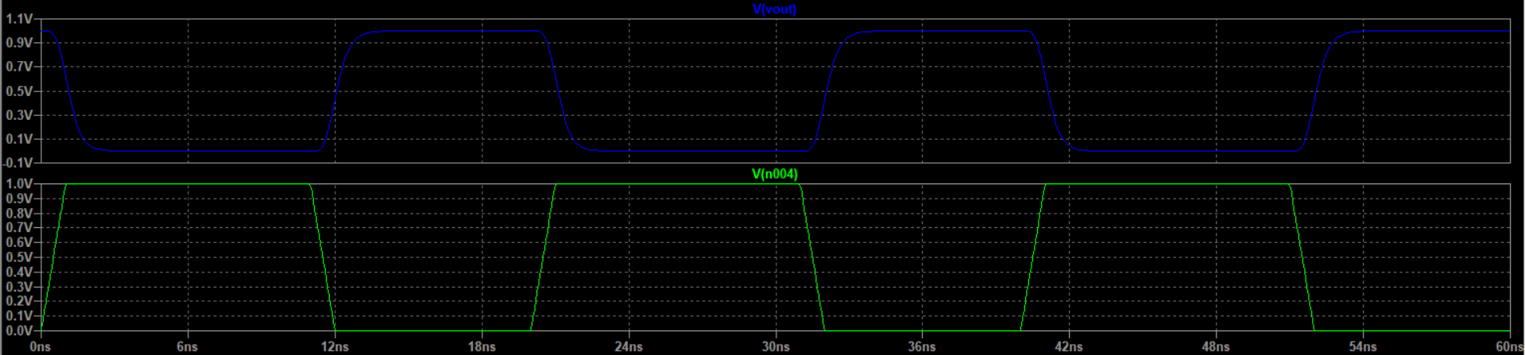
FO4 Inverter’s Output

Slide 38
It’s Delay Characteristics
t1
t2
t3
t4

Slide 39
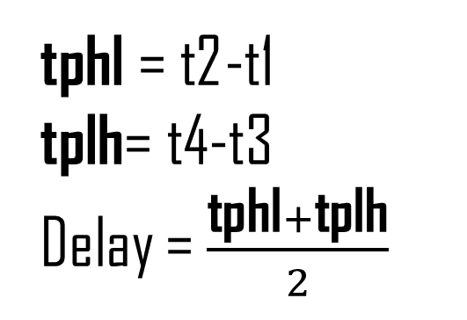
Delay Equation
*Delay calulation spice code
*modify this code according to you
.meas time1 FIND time WHEN V(n004) = 0.35 RISE=1
.meas time2 FIND time WHEN V(vout) = 0.35 FALL=1
.meas tPHL param time2-time1
.meas time3 FIND time WHEN V(n004) = 0.35 FALL=1
.meas time4 FIND time WHEN V(vout) = 0.35 RISE=1
.meas tPLH param time4-time3
.meas delay param (tPHL+tPLH)/2
tphl = t2-t1
tplh= t4-t3
Delay = $\frac{\text{tphl}+\text{tplh}}{2}$
time1: time=3.5e-10 at 3.5e-10
time2: time=1.28818e-09 at 1.28818e-09
tphl: time2-time1=9.3818e-10
time3: time=1.165e-08 at 1.165e-08
time4: time=1.19229e-08 at 1.19229e-08
tplh: time4-time3=2.7287e-10
delay: (tphl+tplh)/2=6.05525e-10

Slide 40
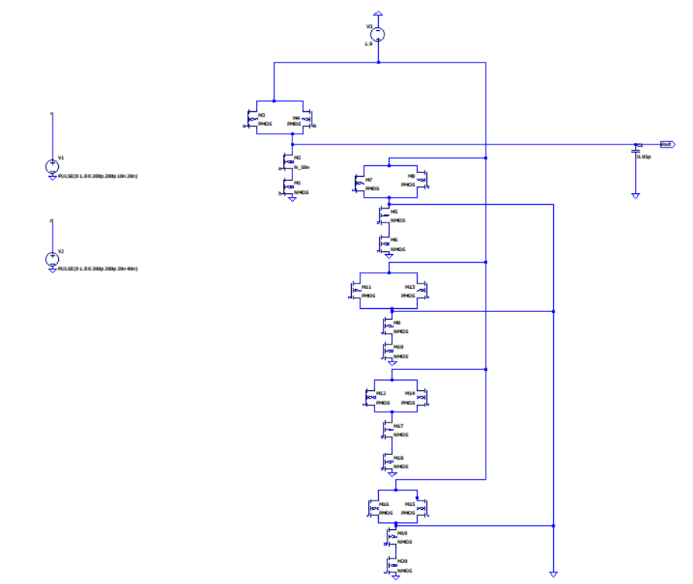
FO4 DELAY NAND GATE

Slide 41
Models of 50nm pmos and nmos
.model P_50n pmos level=54 +binunit=1 paramchk=1 mobmod=0 +capmod=2 igcmod=1 igbmod=1 geomod=0 +diomod=1 rdsmod=0 rbodymod=1 rgatemod=1 +permod=1 acnqsmod=0 trnqsmod=0 +tnom=27 toxe=1.4e-009 toxp=7e-010 toxm=1.4e-009 +epsrox=3.9 wint=5e-009 lint=1.2e-008 +ll=0 wl=0 lln=1 wln=1 +lw=0 ww=0 lwn=1 wwn=1 +lwl=0 wwl=0 xpart=0 toxref=1.4e-009 +vth0=-0.22 k1=0.39 k2=0.05 k3=0 +k3b=0 w0=2.5e-006 dvt0=3.9 dvt1=0.635 +dvt2=-0.032 dvt0w=0 dvt1w=0 dvt2w=0 +dsub=0.7 minv=0.05 voffl=0 dvtp0=0.5e-008 +dvtp1=0.05 lpe0=5.75e-008 lpeb=2.3e-010 xj=2e-008 +ngate=5e+020 ndep=2.8e+018 nsd=1e+020 phin=0 +cdsc=0.000258 cdscb=0 cdscd=6.1e-008 cit=0 +voff=-0.15 nfactor=2 eta0=0.15 etab=0 +vfb=0.55 u0=0.0095 ua=1.6e-009 ub=8e-018 +uc=4.6e-013 vsat=90000 a0=1.2 ags=1e-020 +a1=0 a2=1 b0=-1e-020 b1=0 +keta=-0.047 dwg=0 dwb=0 pclm=0.55 +pdiblc1=0.03 pdiblc2=0.0055 pdiblcb=3.4e-008 drout=0.56 +pvag=1e-020 delta=0.014 pscbe1=8.14e+008 pscbe2=9.58e-007 +fprout=0.2 pdits=0.2 pditsd=0.23 pditsl=2.3e+006 +rsh=3 rdsw=250 rsw=160 rdw=160 +rdswmin=0 rdwmin=0 rswmin=0 prwg=3.22e-008 +prwb=6.8e-011 wr=1 alpha0=0.074 alpha1=0.005 +beta0=30 agidl=0.0002 bgidl=2.1e+009 cgidl=0.0002 +egidl=0.8 +aigbacc=0.012 bigbacc=0.0028 cigbacc=0.002 +nigbacc=1 aigbinv=0.014 bigbinv=0.004 cigbinv=0.004 +eigbinv=1.1 nigbinv=3 aigc=0.69 bigc=0.0012 +cigc=0.0008 aigsd=0.0087 bigsd=0.0012 cigsd=0.0008 +nigc=1 poxedge=1 pigcd=1 ntox=1 +xrcrg1=12 xrcrg2=5 +cgso=7.43e-010 cgdo=7.43e-010 cgbo=2.56e-011 cgdl=1e-014 +cgsl=1e-014 ckappas=0.5 ckappad=0.5 acde=1 +moin=15 noff=0.9 voffcv=0.02 +kt1=-0.19 kt1l=0 kt2=-0.052 ute=-1.5 +ua1=-1e-009 ub1=2e-018 uc1=0 prt=0 +at=33000 +fnoimod=1 tnoimod=0 +jss=0.0001 jsws=1e-011 jswgs=1e-010 njs=1 +ijthsfwd=0.01 ijthsrev=0.001 bvs=10 xjbvs=1 +jsd=0.0001 jswd=1e-011 jswgd=1e-010 njd=1 +ijthdfwd=0.01 ijthdrev=0.001 bvd=10 xjbvd=1 +pbs=1 cjs=0.0005 mjs=0.5 pbsws=1 +cjsws=5e-010 mjsws=0.33 pbswgs=1 cjswgs=5e-010 +mjswgs=0.33 pbd=1 cjd=0.0005 mjd=0.5 +pbswd=1 cjswd=5e-010 mjswd=0.33 pbswgd=1 +cjswgd=5e-010 mjswgd=0.33 tpb=0.005 tcj=0.001 +tpbsw=0.005 tcjsw=0.001 tpbswg=0.005 tcjswg=0.001 +xtis=3 xtid=3 +dmcg=0e-006 dmci=0e-006 dmdg=0e-006 dmcgt=0e-007 +dwj=0e-008 xgw=0e-007 xgl=0e-008 +rshg=0.4 gbmin=1e-010 rbpb=5 rbpd=15 +rbps=15 rbdb=15 rbsb=15 ngcon=1

Slide 42
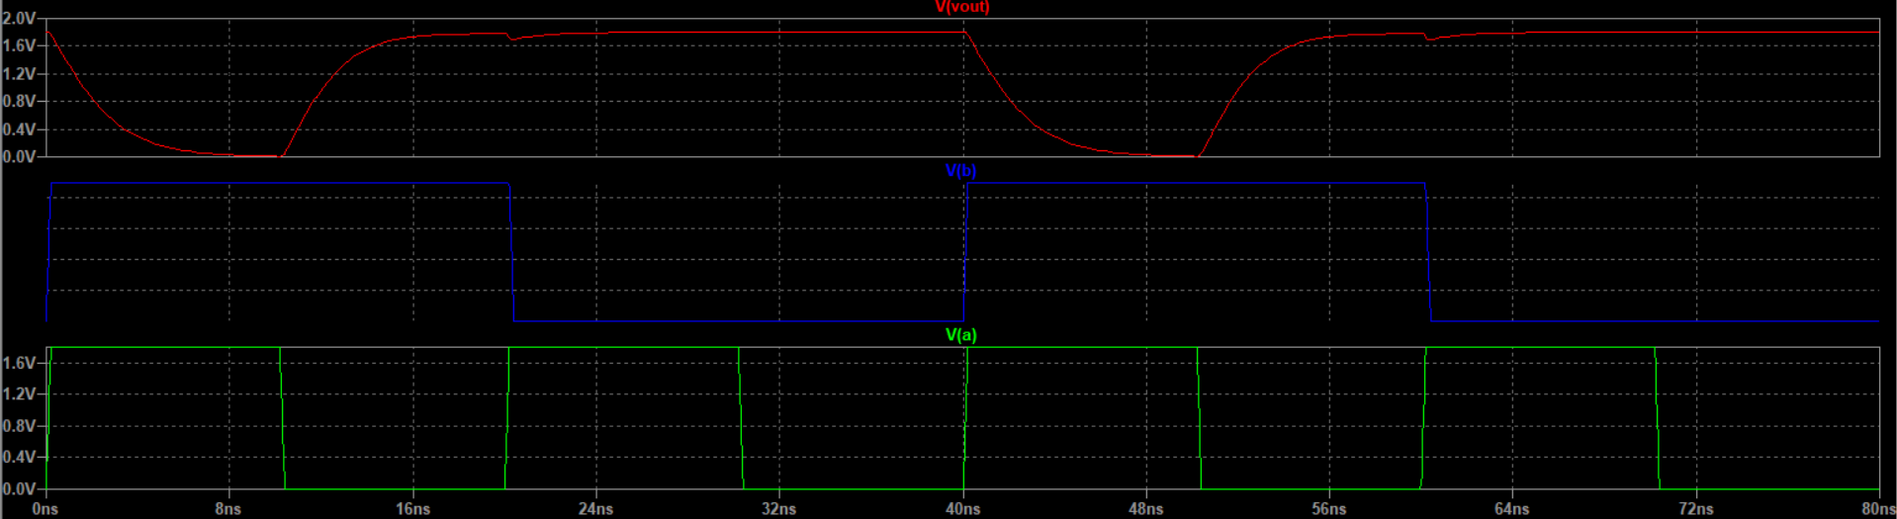
It’s Output Characteristics :

Slide 43
Scripting code of Inverter
*inverter.sp
.param SUPPLY=1.8
.lib "C:\Users\HITIK KUMAR NAYAK\OneDrive\Desktop\nit raipur\50nm_model.txt"
*--------------simulation netlist-------
VDD vdd gnd 'SUPPLY'
Vin1 a gnd PULSE 0 'SUPPLY' 0ps 5ps 5ps 30ps 80ps
M1 y a vdd vdd PMOS W=200n L=50n
M2 y a gnd gnd NMOS W=100n L=50n
*---simulation---
.tran 10ps 300ps
*----------------------
*Delay calculation spice code
*modify this code according to you
.meas time1 FIND time WHEN V(a) = 0.9 RISE=1
.meas time2 FIND time WHEN V(y) = 0.9 FALL=1
.meas tPHL param time2-time1
.meas time3 FIND time WHEN V(a) = 0.9 FALL=1
.meas time4 FIND time WHEN V(y) = 0.9 RISE=1
.meas tPLH param time4-time3
.meas delay param (tPHL+tPLH)/2
.end

Slide 44
Model of 50nm which is saved in my file
.model P_50n pmos level=54 +binunit=1 paramchk=1 mobmod=0 +capmod=2 igcmod=1 igbmod=1 geomod=0 +diomod=1 rdsmod=0 rbodymod=1 rgatemod=1 +permod=1 acnqsmod=0 trnqsmod=0 +tnom=27 toxe=1.4e-009 toxp=7e-010 toxm=1.4e-009 +epsrox=3.9 wint=5e-009 lint=1.2e-008 +ll=0 wl=0 lln=1 wln=1 +lw=0 ww=0 lwn=1 wwn=1 +lwl=0 wwl=0 xpart=0 toxref=1.4e-009 +vth0=-0.22 k1=0.39 k2=0.05 k3=0 +k3b=0 w0=2.5e-006 dvt0=3.9 dvt1=0.635 +dvt2=-0.032 dvt0w=0 dvt1w=0 dvt2w=0 +dsub=0.7 minv=0.05 voffl=0 dvtp0=0.5e-008 +dvtp1=0.05 lpe0=5.75e-008 lpeb=2.3e-010 xj=2e-008 +ngate=5e+020 ndep=2.8e+018 nsd=1e+020 phin=0 +cdsc=0.000258 cdscb=0 cdscd=6.1e-008 cit=0 +voff=-0.15 nfactor=2 eta0=0.15 etab=0 +vfb=0.55 u0=0.0095 ua=1.6e-009 ub=8e-018 +uc=4.6e-013 vsat=90000 a0=1.2 ags=1e-020 +a1=0 a2=1 b0=-1e-020 b1=0 +keta=-0.047 dwg=0 dwb=0 pclm=0.55 +pdiblc1=0.03 pdiblc2=0.0055 pdiblcb=3.4e-008 drout=0.56 +pvag=1e-020 delta=0.014 pscbe1=8.14e+008 pscbe2=9.58e-007 +fprout=0.2 pdits=0.2 pditsd=0.23 pditsl=2.3e+006 +rsh=3 rdsw=250 rsw=160 rdw=160 +rdswmin=0 rdwmin=0 rswmin=0 prwg=3.22e-008 +prwb=6.8e-011 wr=1 alpha0=0.074 alpha1=0.005 +beta0=30 agidl=0.0002 bgidl=2.1e+009 cgidl=0.0002 +egidl=0.8 +aigbacc=0.012 bigbacc=0.0028 cigbacc=0.002 +nigbacc=1 aigbinv=0.014 bigbinv=0.004 cigbinv=0.004 +eigbinv=1.1 nigbinv=3 aigc=0.69 bigc=0.0012 +cigc=0.0008 aigsd=0.0087 bigsd=0.0012 cigsd=0.0008 +nigc=1 poxedge=1 pigcd=1 ntox=1 +xrcrg1=12 xrcrg2=5 +cgso=7.43e-010 cgdo=7.43e-010 cgbo=2.56e-011 cgdl=1e-014 +cgsl=1e-014 ckappas=0.5 ckappad=0.5 acde=1 +moin=15 noff=0.9 voffcv=0.02 +kt1=-0.19 kt1l=0 kt2=-0.052 ute=-1.5 +ua1=-1e-009 ub1=2e-018 uc1=0 prt=0 +at=33000 +fnoimod=1 tnoimod=0 +jss=0.0001 jsws=1e-011 jswgs=1e-010 njs=1 +ijthsfwd=0.01 ijthsrev=0.001 bvs=10 xjbvs=1 +jsd=0.0001 jswd=1e-011 jswgd=1e-010 njd=1 +ijthdfwd=0.01 ijthdrev=0.001 bvd=10 xjbvd=1 +pbs=1 cjs=0.0005 mjs=0.5 pbsws=1 +cjsws=5e-010 mjsws=0.33 pbswgs=1 cjswgs=5e-010 +mjswgs=0.33 pbd=1 cjd=0.0005 mjd=0.5 +pbswd=1 cjswd=5e-010 mjswd=0.33 pbswgd=1 +cjswgd=5e-010 mjswgd=0.33 tpb=0.005 tcj=0.001 +tpbsw=0.005 tcjsw=0.001 tpbswg=0.005 tcjswg=0.001 +xtis=3 xtid=3 +dmcg=0e-006 dmci=0e-006 dmdg=0e-006 dmcgt=0e-007 +dwj=0e-008 xgw=0e-007 xgl=0e-008 +rshg=0.4 gbmin=1e-010 rbpb=5 rbpd=15 +rbps=15 rbdb=15 rbsb=15 ngcon=1

Slide 45
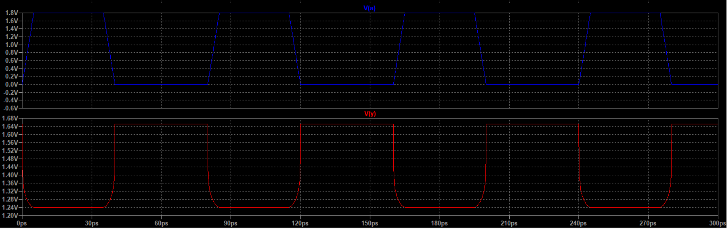
Output Characteristics of Inverter

Slide 46
Scripting code of NAND Gate
*nand.sp
.param SUPPLY=1.8
.lib "C:\Users\HITIK KUMAR NAYAK\OneDrive\Desktop\nit raipur\50nm_model.txt"
*--------------simulation netlist-------
VDD vdd gnd 'SUPPLY'
Vin1 a gnd PULSE 0 'SUPPLY' 0ps 5ps 5ps 30ps 80ps
vin2 b gnd 1.8
M1 y a vdd vdd PMOS W=200n L=50n
M2 y b vdd vdd PMOS W=200n L=50n
M3 y a z z NMOS W=100n L=50n
M4 z b gnd gnd NMOS W=200n L=50n
*---simulation---
.tran 10ps 300ps
*----------------------
*Delay calulation spice code
*modify this code according to you
.meas time1 FIND time WHEN V(a) = 0.9 RISE=1
.meas time2 FIND time WHEN V(y) = 0.9 FALL=1
.meas tPHL param time2-time1
.meas time3 FIND time WHEN V(a) = 0.9 FALL=1
.meas time4 FIND time WHEN V(y) = 0.9 RISE=1
.meas tPLH param time4-time3
.meas delay param (tPHL+tPLH)/2
.end

Slide 47
Model of 50nm which is saved in my file
.model P_50n pmos level=54 +binunit=1 paramchk=1 mobmod=0 +capmod=2 igcmod=1 igbmod=1 geomod=0 +diomod=1 rdsmod=0 rbodymod=1 rgatemod=1 +permod=1 acnqsmod=0 trnqsmod=0 +tnom=27 toxe=1.4e-009 toxp=7e-010 toxm=1.4e-009 +epsrox=3.9 wint=5e-009 lint=1.2e-008 +ll=0 wl=0 lln=1 wln=1 +lw=0 ww=0 lwn=1 wwn=1 +lwl=0 wwl=0 xpart=0 toxref=1.4e-009 +vth0=-0.22 k1=0.39 k2=0.05 k3=0 +k3b=0 w0=2.5e-006 dvt0=3.9 dvt1=0.635 +dvt2=-0.032 dvt0w=0 dvt1w=0 dvt2w=0 +dsub=0.7 minv=0.05 voffl=0 dvtp0=0.5e-008 +dvtp1=0.05 lpe0=5.75e-008 lpeb=2.3e-010 xj=2e-008 +ngate=5e+020 ndep=2.8e+018 nsd=1e+020 phin=0 +cdsc=0.000258 cdscb=0 cdscd=6.1e-008 cit=0 +voff=-0.15 nfactor=2 eta0=0.15 etab=0 +vfb=0.55 u0=0.0095 ua=1.6e-009 ub=8e-018 +uc=4.6e-013 vsat=90000 a0=1.2 ags=1e-020 +a1=0 a2=1 b0=-1e-020 b1=0 +keta=-0.047 dwg=0 dwb=0 pclm=0.55 +pdiblc1=0.03 pdiblc2=0.0055 pdiblcb=3.4e-008 drout=0.56 +pvag=1e-020 delta=0.014 pscbe1=8.14e+008 pscbe2=9.58e-007 +fprout=0.2 pdits=0.2 pditsd=0.23 pditsl=2.3e+006 +rsh=3 rdsw=250 rsw=160 rdw=160 +rdswmin=0 rdwmin=0 rswmin=0 prwg=3.22e-008 +prwb=6.8e-011 wr=1 alpha0=0.074 alpha1=0.005 +beta0=30 agidl=0.0002 bgidl=2.1e+009 cgidl=0.0002 +egidl=0.8 +aigbacc=0.012 bigbacc=0.0028 cigbacc=0.002 +nigbacc=1 aigbinv=0.014 bigbinv=0.004 cigbinv=0.004 +eigbinv=1.1 nigbinv=3 aigc=0.69 bigc=0.0012 +cigc=0.0008 aigsd=0.0087 bigsd=0.0012 cigsd=0.0008 +nigc=1 poxedge=1 pigcd=1 ntox=1 +xrcrg1=12 xrcrg2=5 +cgso=7.43e-010 cgdo=7.43e-010 cgbo=2.56e-011 cgdl=1e-014 +cgsl=1e-014 ckappas=0.5 ckappad=0.5 acde=1 +moin=15 noff=0.9 voffcv=0.02 +kt1=-0.19 kt1l=0 kt2=-0.052 ute=-1.5 +ua1=-1e-009 ub1=2e-018 uc1=0 prt=0 +at=33000 +fnoimod=1 tnoimod=0 +jss=0.0001 jsws=1e-011 jswgs=1e-010 njs=1 +ijthsfwd=0.01 ijthsrev=0.001 bvs=10 xjbvs=1 +jsd=0.0001 jswd=1e-011 jswgd=1e-010 njd=1 +ijthdfwd=0.01 ijthdrev=0.001 bvd=10 xjbvd=1 +pbs=1 cjs=0.0005 mjs=0.5 pbsws=1 +cjsws=5e-010 mjsws=0.33 pbswgs=1 cjswgs=5e-010 +mjswgs=0.33 pbd=1 cjd=0.0005 mjd=0.5 +pbswd=1 cjswd=5e-010 mjswd=0.33 pbswgd=1 +cjswgd=5e-010 mjswgd=0.33 tpb=0.005 tcj=0.001 +tpbsw=0.005 tcjsw=0.001 tpbswg=0.005 tcjswg=0.001 +xtis=3 xtid=3 +dmcg=0e-006 dmci=0e-006 dmdg=0e-006 dmcgt=0e-007 +dwj=0e-008 xgw=0e-007 xgl=0e-008 +rshg=0.4 gbmin=1e-010 rbpb=5 rbpd=15 +rbps=15 rbdb=15 rbsb=15 ngcon=1

Slide 48
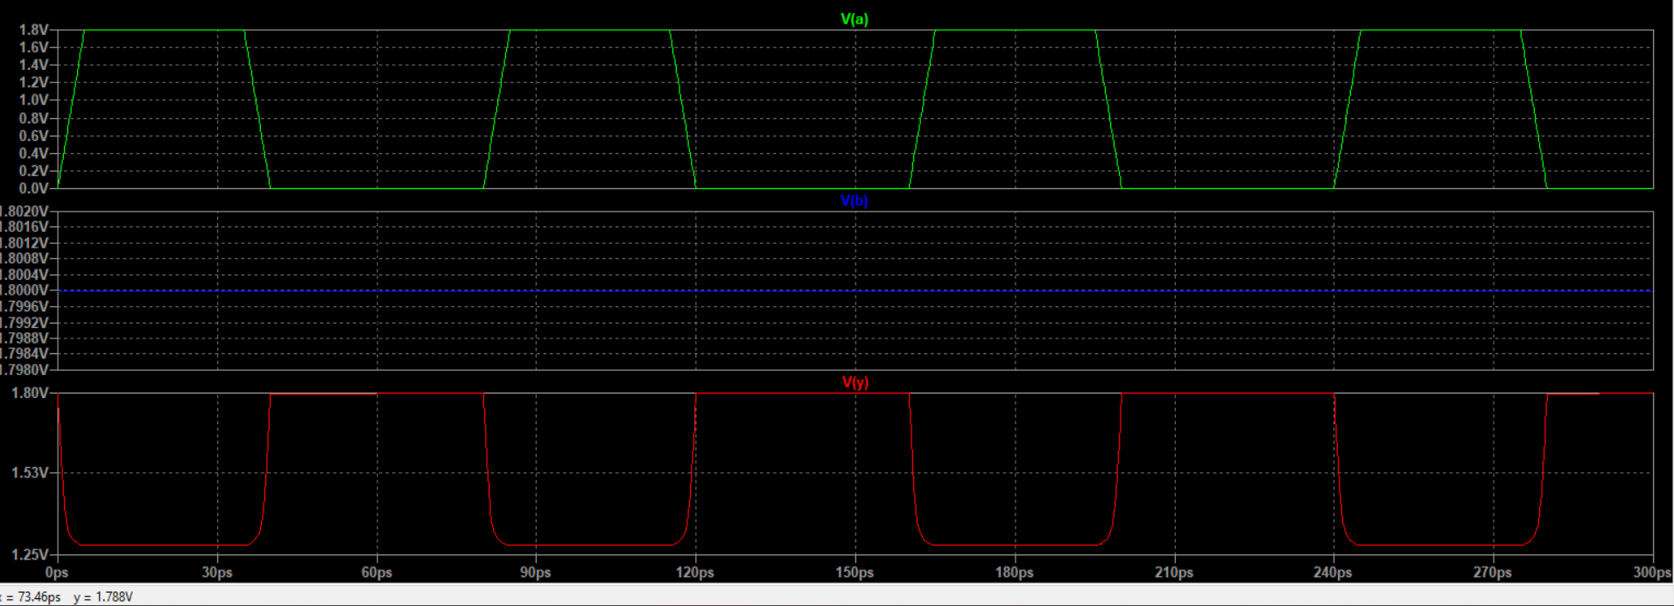
Output Characteristics of NAND Gate

Slide 49
Scripting code of NOR Gate
*nor.sp
.param SUPPLY=1.8
.lib "C:\Users\HITIK KUMAR NAYAK\OneDrive\Desktop\nit raipur\50nm_model.txt"
*--------------simulation netlist-------
VDD vdd gnd 'SUPPLY'
Vin1 a gnd PULSE 0 'SUPPLY' 0ps 5ps 5ps 30ps 80ps
vin2 b gnd PULSE 0 'SUPPLY' 0ps 5ps 5ps 30ps 80ps
M1 y a vdd vdd PMOS W=200n L=50n
M2 y b vdd vdd PMOS W=200n L=50n
M3 y a gnd gnd NMOS W=100n L=50n
M4 y b gnd gnd NMOS W=100n L=50n
*---simulation---
.tran 10ps 300ps
*----------------------
*Delay calculation spice code
*modify this code according to you
.meas time1 FIND time WHEN V(a) = 0.9 RISE=1
.meas time2 FIND time WHEN V(y) = 0.9 FALL=1
.meas tPHL param time2-time1
.meas time3 FIND time WHEN V(a) = 0.9 FALL=1
.meas time4 FIND time WHEN V(y) = 0.9 RISE=1
.meas tPLH param time4-time3
.meas delay param (tPHL+tPLH)/2
.end

Slide 50
Model of 50nm which is saved in my file
.model P_50n pmos level=54 +binunit=1 paramchk=1 mobmod=0 +capmod=2 igcmod=1 igbmod=1 geomod=0 +diomod=1 rdsmod=0 rbodymod=1 rgatemod=1 +permod=1 acnqsmod=0 trnqsmod=0 +tnom=27 toxe=1.4e-009 toxp=7e-010 toxm=1.4e-009 +epsrox=3.9 wint=5e-009 lint=1.2e-008 +ll=0 wl=0 lln=1 wln=1 +lw=0 ww=0 lwn=1 wwn=1 +lwl=0 wwl=0 xpart=0 toxref=1.4e-009 +vth0=-0.22 k1=0.39 k2=0.05 k3=0 +k3b=0 w0=2.5e-006 dvt0=3.9 dvt1=0.635 +dvt2=-0.032 dvt0w=0 dvt1w=0 dvt2w=0 +dsub=0.7 minv=0.05 voffl=0 dvtp0=0.5e-008 +dvtp1=0.05 lpe0=5.75e-008 lpeb=2.3e-010 xj=2e-008 +ngate=5e+020 ndep=2.8e+018 nsd=1e+020 phin=0 +cdsc=0.000258 cdscb=0 cdscd=6.1e-008 cit=0 +voff=-0.15 nfactor=2 eta0=0.15 etab=0 +vfb=0.55 u0=0.0095 ua=1.6e-009 ub=8e-018 +uc=4.6e-013 vsat=90000 a0=1.2 ags=1e-020 +a1=0 a2=1 b0=-1e-020 b1=0 +keta=-0.047 dwg=0 dwb=0 pclm=0.55 +pdiblc1=0.03 pdiblc2=0.0055 pdiblcb=3.4e-008 drout=0.56 +pvag=1e-020 delta=0.014 pscbe1=8.14e+008 pscbe2=9.58e-007 +fprout=0.2 pdits=0.2 pditsd=0.23 pditsl=2.3e+006 +rsh=3 rdsw=250 rsw=160 rdw=160 +rdswmin=0 rdwmin=0 rswmin=0 prwg=3.22e-008 +prwb=6.8e-011 wr=1 alpha0=0.074 alpha1=0.005 +beta0=30 agidl=0.0002 bgidl=2.1e+009 cgidl=0.0002 +egidl=0.8 +aigbacc=0.012 bigbacc=0.0028 cigbacc=0.002 +nigbacc=1 aigbinv=0.014 bigbinv=0.004 cigbinv=0.004 +eigbinv=1.1 nigbinv=3 aigc=0.69 bigc=0.0012 +cigc=0.0008 aigsd=0.0087 bigsd=0.0012 cigsd=0.0008 +nigc=1 poxedge=1 pigcd=1 ntox=1 +xrcrg1=12 xrcrg2=5 +cgso=7.43e-010 cgdo=7.43e-010 cgbo=2.56e-011 cgdl=1e-014 +cgsl=1e-014 ckappas=0.5 ckappad=0.5 acde=1 +moin=15 noff=0.9 voffcv=0.02 +kt1=-0.19 kt1l=0 kt2=-0.052 ute=-1.5 +ua1=-1e-009 ub1=2e-018 uc1=0 prt=0 +at=33000 +fnoimod=1 tnoimod=0 +jss=0.0001 jsws=1e-011 jswgs=1e-010 njs=1 +ijthsfwd=0.01 ijthsrev=0.001 bvs=10 xjbvs=1 +jsd=0.0001 jswd=1e-011 jswgd=1e-010 njd=1 +ijthdfwd=0.01 ijthdrev=0.001 bvd=10 xjbvd=1 +pbs=1 cjs=0.0005 mjs=0.5 pbsws=1 +cjsws=5e-010 mjsws=0.33 pbswgs=1 cjswgs=5e-010 +mjswgs=0.33 pbd=1 cjd=0.0005 mjd=0.5 +pbswd=1 cjswd=5e-010 mjswd=0.33 pbswgd=1 +cjswgd=5e-010 mjswgd=0.33 tpb=0.005 tcj=0.001 +tpbsw=0.005 tcjsw=0.001 tpbswg=0.005 tcjswg=0.001 +xtis=3 xtid=3 +dmcg=0e-006 dmci=0e-006 dmdg=0e-006 dmcgt=0e-007 +dwj=0e-008 xgw=0e-007 xgl=0e-008 +rshg=0.4 gbmin=1e-010 rbpb=5 rbpd=15 +rbps=15 rbdb=15 rbsb=15 ngcon=1

Slide 51
Sub-Circuit
In CMOS (Complementary Metal-Oxide-Semiconductor) technology, a sub-circuit refers to a distinct functional block within a larger integrated circuit (IC). Here are the key points:
Functional Blocks: Examples include logic gates (AND, OR, NOT), flip-flops, multiplexers, and memory cells.
Modularity: Sub-circuits help in designing complex CMOS circuits by breaking them into smaller, manageable modules.
Hierarchical Design: CMOS ICs use hierarchical design where sub-circuits are organized into higher-level structures, simplifying design and verification.
Reusable Components: Standard cells or IP blocks are often used as sub-circuits, allowing reuse across different designs.
Performance Optimization: Sub-circuits are individually optimized for power, speed, and area before integrating into the larger system.

Slide 52
16nm model of ConventionalFull Adder
Vdd (in V) | Sum Delay | Carry Delay | A.P.D
0.8 | 205.1ps | 32.2ps | 1.9mW
1 | 32.8ps | 23.2ps | 6.2uW
1.2 | 32.8ps | 31.9ps | 30.8uW
1.5 | 56.2ps | 68.3ps | 158.8uW

Slide 53
22nm model of Conventional Full Adder
Vdd (in V) | Sum Delay | Carry Delay | A.P.D
0.8 | 1.4ns | 59.6ps | 2.19mW
1 | 58.2ps | 29.6ps | 1.8uW
1.2 | 55.3ps | 28.3ps | 8.4uW
1.5 | 38.8ps | 29.17ps | 81.4uW

Slide 54
32nm model of Conventional Full Adder
Vdd (in V) | Sum Delay (in ps) | Carry Delay(in ns) | A.P.D
0.8 | ---- | ---- | 93.9 nW
1 | 125.6 | 12.3 | 929.3 nW
1.2 | 48.4 | 2.4 | 1.6 uW
1.5 | 45.5 | 2.3 | 16.6 uW

Slide 56
Highlights
•Design of high performance 20T Hybrid full adder (FA) is proposed.
•Best performance at supply voltage (0.8–1.5V) and process corner.
•Full voltage swing at all the internal and external nodes.
•Proposed Hybrid FA reported low delay and power delay product (PDP) against reviewed circuits.

Slide 57
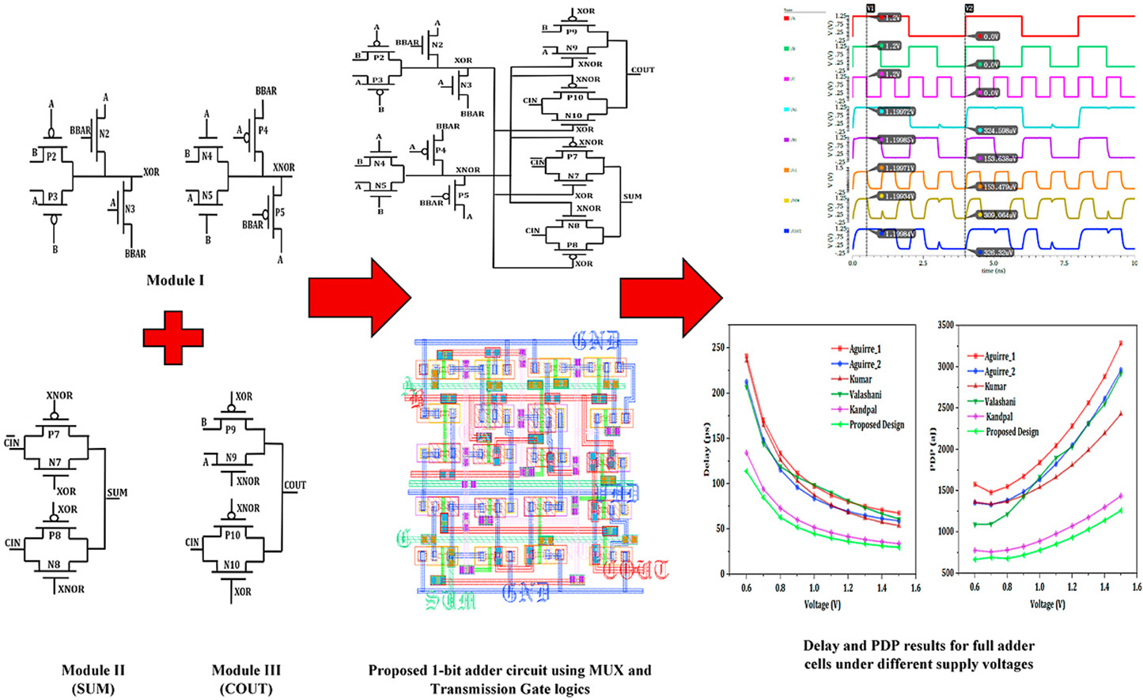

Slide 58
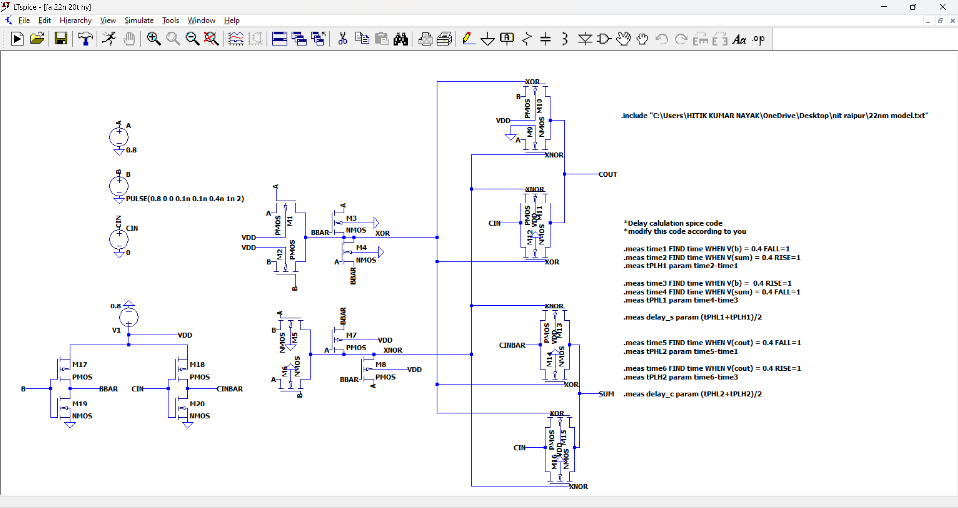

Slide 59
 | 16nm | 16nm | 22nm | 22nm | 32nm | 32nm
Vdd(in Volt) | SUM | CARRY | SUM | CARRY | SUM | CARRY
0.8V | 16.2ps | 18.4ps | 29.5ps | 32.2ps | 33.5ps | 38.6ps
1V | 9ps | 9.4ps | 22.4ps | 23.7ps | 18.6ps | 20.6ps
1.2V | 6.8ps | 7.4ps | 18.3ps | 18.7ps | 13.5ps | 13.3ps
1.5V | 4.9ps | 6.5ps | 15ps | 14.2ps | 10.7ps | 10.1ps
 | 16nm | 16nm | 16nm | 22nm | 22nm | 22nm | 32nm | 32nm | 32nm
Vdd(inVolt) | Avg P (uW) | Sum PDP (aJ) | Carry PDP (aJ) | Avg P (uW) | Sum PDP (aJ) | Carry PDP (aJ) | Avg P (uW) | Sum PDP (uW) | Carry PDP (uW)
0.8V | 2.7 | 43.7 | 49.6 | 1.8 | 53.1 | 57.9 | 1.4 | 46.9 | 54
1V | 9.9 | 89.1 | 93 | 6.2 | 138.8 | 146.9 | 5.9 | 109.7 | 121.5
1.2V | 29.7 | 201.9 | 219.7 | 14.9 | 272.6 | 278.6 | 16.8 | 226.8 | 223.4
1.5V | 105.4 | 516.4 | 685.1 | 43.9 | 658.5 | 623.3 | 54.7 | 585.2 | 552.4

Slide 74
Thank you
Hitik Kumar Nayak
7978594517
hitikkumarnayak22@gmail.com

